Slide 1




6219 - L1 Ext Certificate Construction Skills/Carpentry & Joinery.
Unit 005: Constructing Half Brick Walling.
Half Brick Walling.
Lecturer: James Rix

Slide 2

Aim & Objectives.
Aim:
Know how to set out and build brick walls
Objectives:
1.1 identify the Personal Protective Equipment (PPE) appropriate to building half brick thick walls
1.2 identify the materials required to build half brick thick walls
1.3 identify the tools and equipment required to build half brick thick walls
1.4 state the number of bricks required to build a 1m2 brick walls.

Slide 3

PPE

Slide 4


Activities.
Activity:
005.1a – Gear Up & Get Safe!
Brief:
This activity introduces learners to the essential Personal Protective Equipment (PPE) required when constructing half‑brick thick walls.

Slide 5


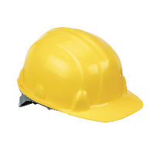
Types of Personal Protective Equipment (PPE).
Hard Hat
Options:
A range of helmets, hard hats and bump caps
Hazards:
Impact from falling or flying objects, risk of head bumping, hair entanglement
Note:
Some safety helmets incorporate or can be fitted with specially-designed eye or hearing protection. Don’t forget neck protection, eg scarves for use during welding. Do not use head protection if it is damaged – replace it.

Slide 6

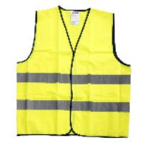
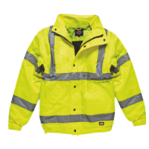
Types of Personal Protective Equipment (PPE).
Hi Vis Vest/Jacket
Options:
Conventional or disposable overalls, boiler suits, specialist protective clothing, eg chain-mail aprons, high-visibility clothing
Hazards:
Temperature extremes, adverse weather, chemical or metal splash, spray from pressure leaks or spray guns, impact or penetration, contaminated dust, excessive wear or entanglement of own clothing.
Note:
The choice of materials includes flame-retardant, anti-static, chain mail, chemically impermeable, and high-visibility. Don’t forget other protection, like safety harnesses or life jackets.

Slide 7

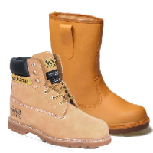
Types of Personal Protective Equipment (PPE).
Safety Boots/Shoes
Options:
Safety boots and shoes with protective toe caps and penetration-resistant mid-sole, gaiters, leggings, spats.
Hazards:
Wet, electrostatic build-up, slipping, cuts and punctures, falling objects, metal and chemical splash, abrasion.
Note: Footwear can have a variety of sole patterns and materials to help prevent slips in different conditions, including oil or chemical-resistant soles. It can also be anti-static, electrically conductive or thermally insulating. It is important that the appropriate footwear is selected for the risks identified

Slide 8

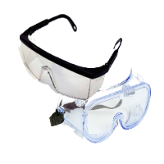
Types of Personal Protective Equipment (PPE).
Safety Specs/Goggles
Options:
Safety spectacles, goggles, face-shields, visors
Hazards:
Chemical or metal splash, dust, projectiles, gas and vapour, radiation
Note:
Make sure the eye protection has the right combination of impact/dust/ splash/molten metal eye protection for the task and fits the user properly.

Slide 9

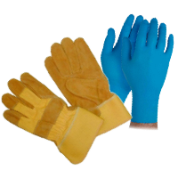
Types of Personal Protective Equipment (PPE).
Safety Gloves
Options:
Gloves, gauntlets, mitts, wrist-cuffs, armlets
Hazards:
Abrasion, temperature extremes, cuts and punctures, impact, chemicals, electric shock, skin infection, disease or contamination.
Note:
Avoid gloves when operating machines such as bench drills where the gloves could get caught. Some materials are quickly penetrated by chemicals so be careful when you are selecting them, see HSE’s skin at work website (www.hse.gov.uk/skin).

Slide 10

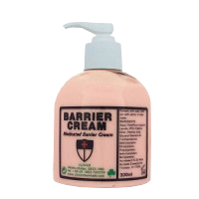
Types of Personal Protective Equipment (PPE).
Barrier Cream
Options:
Barrier Cream
Hazards:
skin infection, disease or contamination
Note:
Barrier creams are unreliable and are no substitute for proper PPE

Slide 11

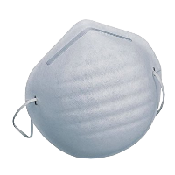
Types of Personal Protective Equipment (PPE).
Dust Mask
Options:
Disposable filtering face-piece or respirator
Hazards:
Dust
Note:
The right type of respirator filter must be used as each is effective for only a limited range of substances.

Slide 12

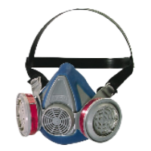
Types of Personal Protective Equipment (PPE).
Respirator
Options:
half- or full-face respirators, airfed helmets, breathing apparatus.
Hazards:
Dust, vapour, gas, oxygen-deficient atmospheres
Note:
The right type of respirator filter must be used as each is effective for only a limited range of substances. Where there is a shortage of oxygen or any danger of losing consciousness due to exposure to high levels of harmful fumes, only use breathing apparatus – never use a filtering cartridge. Filters only have a limited life; when replacing them or any other part, check with the manufacturer’s guidance and ensure the correct replacement part is used

Slide 13

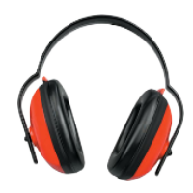
Types of Personal Protective Equipment (PPE).
Ear Defenders
Options:
Foam earplugs, wax balls, ear defenders, Silicon Plugs, Universal Earplugs, otoplasties
Hazards:
Damage to hearing, hearing loss, deafness
Note:
Should be used when noise level is 80 db or more. It is important that the correct type of ear protection is used for the noise level you are working in. This type of PPE is not covered under Personal Protective Equipment At Work Regulations 1992/2002 as it has its own regulation. The Control of Noise at Work Regulations 2005

Slide 14

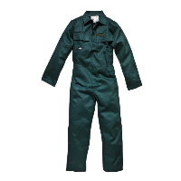
Types of Personal Protective Equipment (PPE).
Overalls
Options:
Conventional or disposable overalls, boiler suits, specialist protective clothing, eg chain-mail aprons
Hazards:
Temperature extremes, adverse weather, chemical or metal splash, spray from pressure leaks or spray guns, impact or penetration, contaminated dust, excessive wear or entanglement of own clothing.
Note:
The choice of materials includes flame-retardant, anti-static, chain mail, chemically impermeable, and high-visibility. Don’t forget other protection, like safety harnesses or life jackets

Slide 15
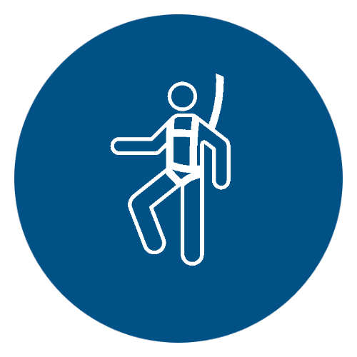
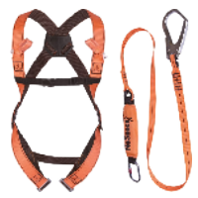
Types of Personal Protective Equipment (PPE).
Harness
Options:
Harness
Hazards:
Falling from height
Note:
This is not covered under the Personal protection Equipment At Work 1992/2002, it has its own regulation. Working at Height regulations 2005

Slide 16

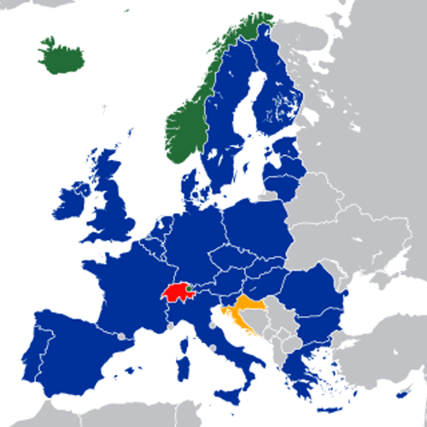
Conformite Europeenne.
CE Marking.
It is extremely important when buying PPE that you make sure
that this symbol is displayed on the item being bought. This marking
is covered under the European Directive 89/686/EEC and ensures that the quality of the PPE is of acceptable standards. Always buy CE marked PPE.
European Economic Area

Slide 17
Materials

Slide 18
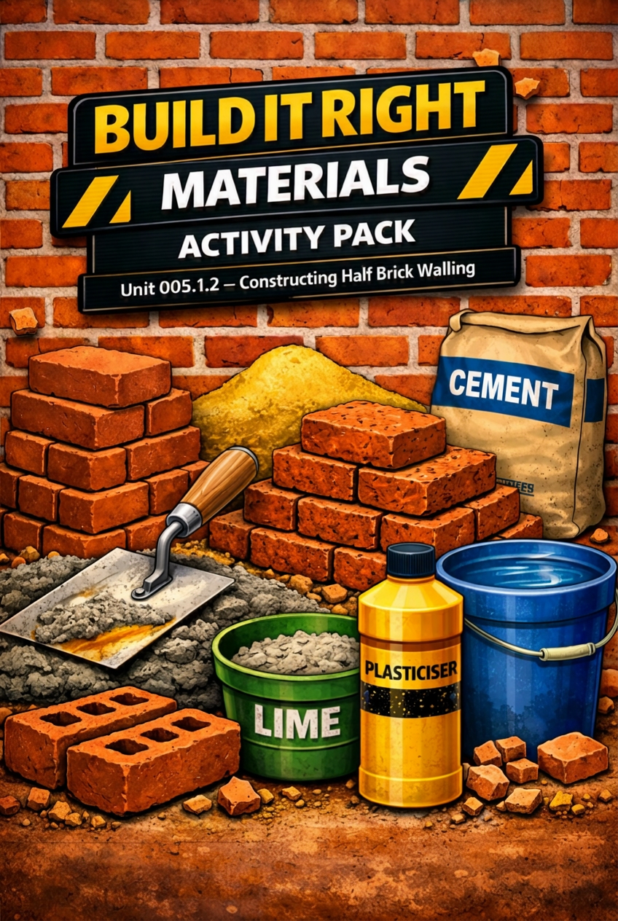
Activities.
Activity:
005.1.2: Build It Right.
Brief:
This activity introduces learners to the core materials used when constructing half‑brick thick walls. Learners will explore the differences between common bricks, facing bricks, and mortar, and understand how each contributes to the structure, strength, and appearance of brickwork.

Slide 19
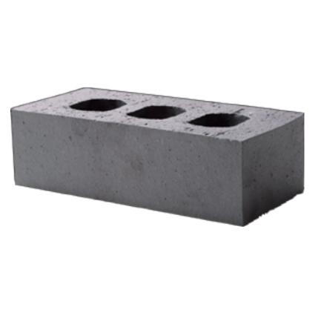
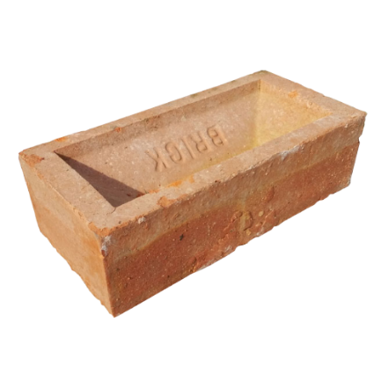
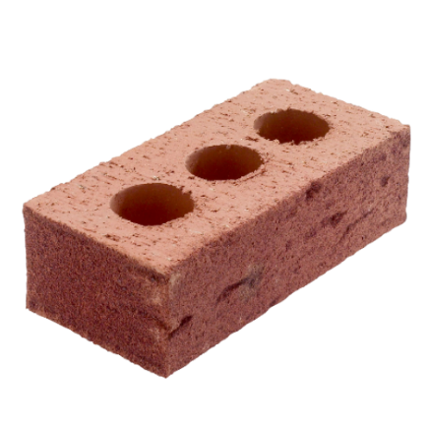
Bricks.
Engineering Brick
Common Brick
Facing Brick

Slide 20
Brick Size.
215mm
65mm
102.5mm

Slide 21
Brick Parts.
Arris
Frog
Stretcher
Header

Slide 22
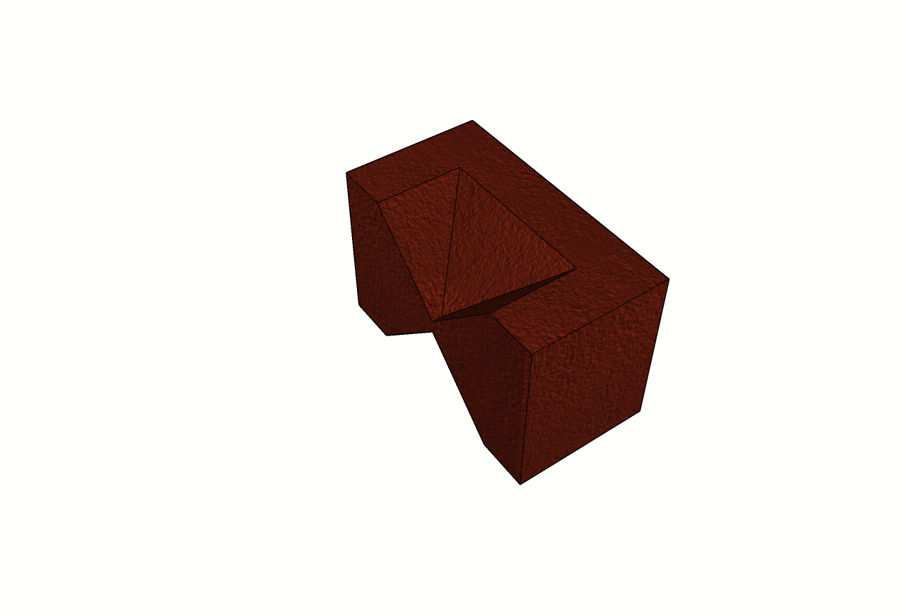
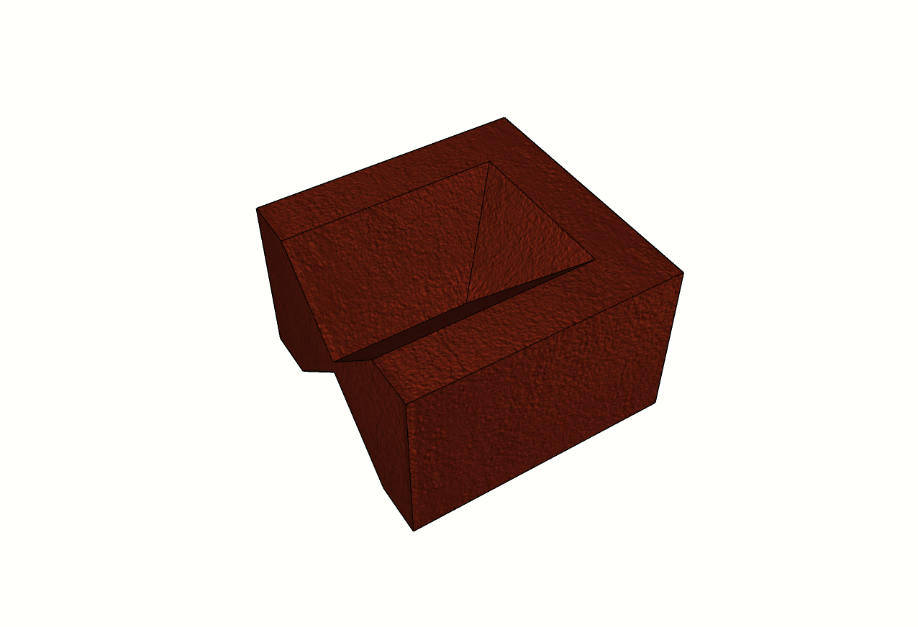
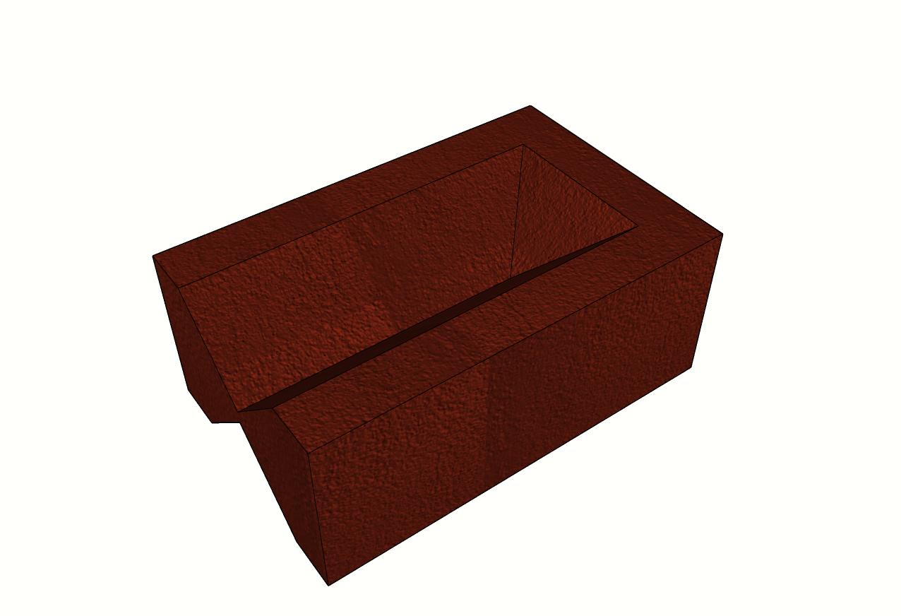
Brick Bats.
Quarter
Bat
3 Quarter
Bat
Half Bat

Slide 23
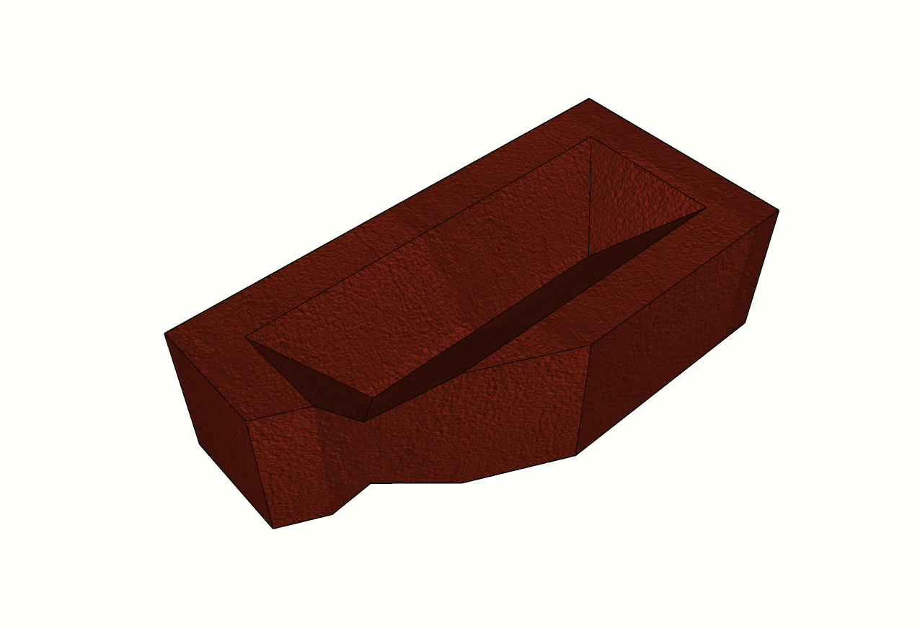
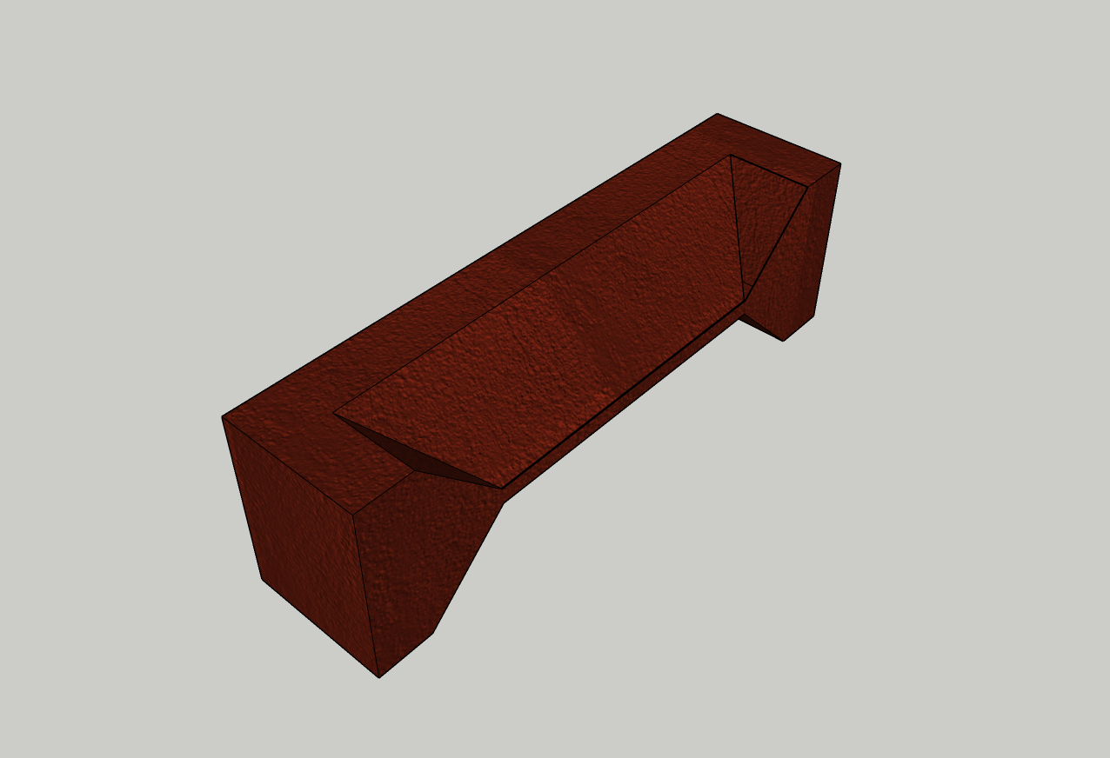
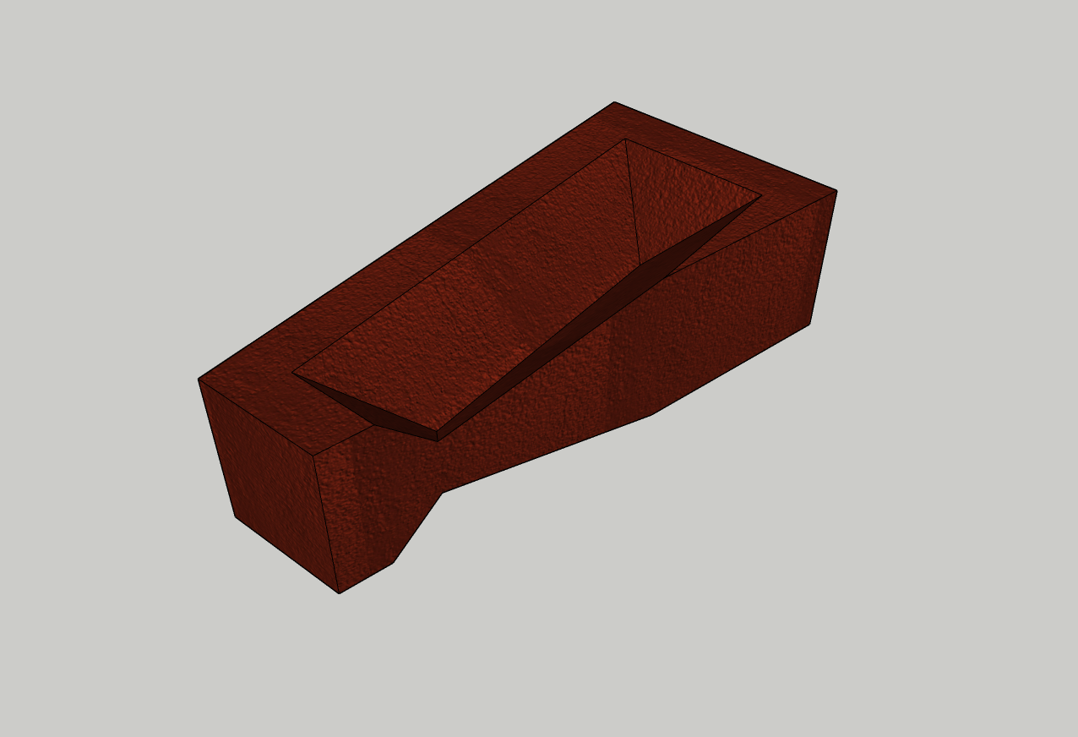
Brick Closers.
King
Closer
Beveled
Closer
Queen
Closer

Slide 24
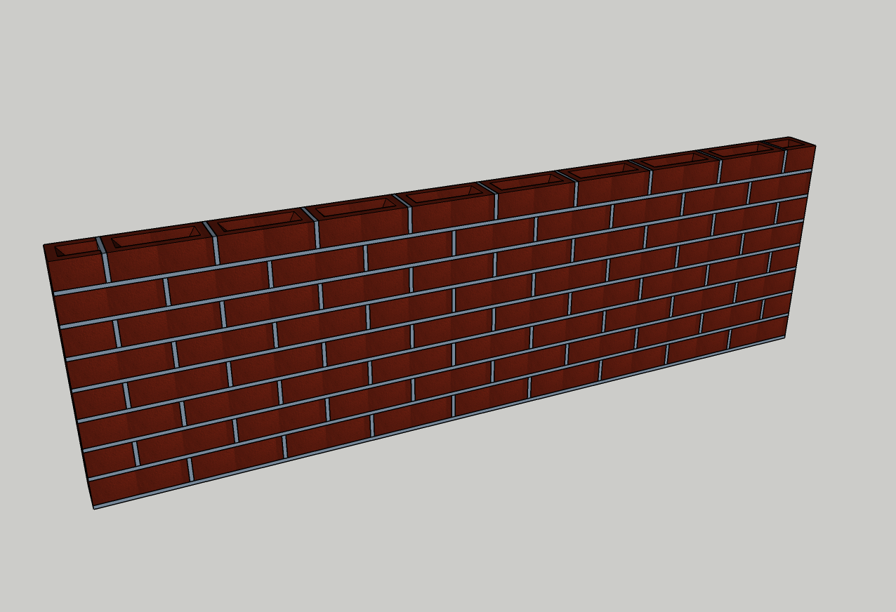
Brick Bonds.
Stretcher
Contains full and half bat bricks. Course 1 is a series of full bricks with the second course beginning with a half bat followed by full bricks

Slide 25
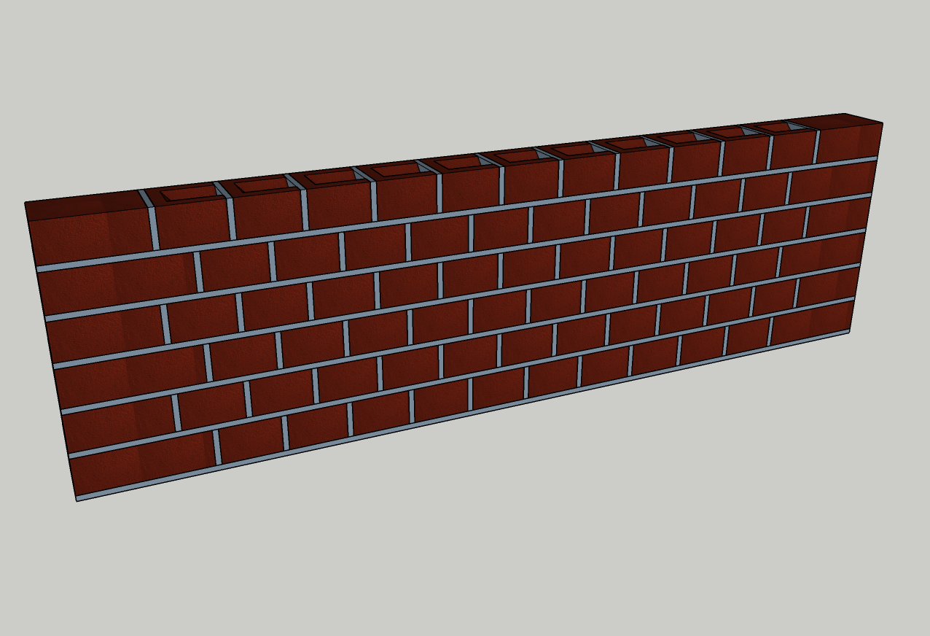
Brick Bonds.
Header
Contains full bricks and half bats and 3 quarter bats. Course 1 is a full brick followed by a series of half bats; second course is a 3-quarter bat followed by half bats.

Slide 26
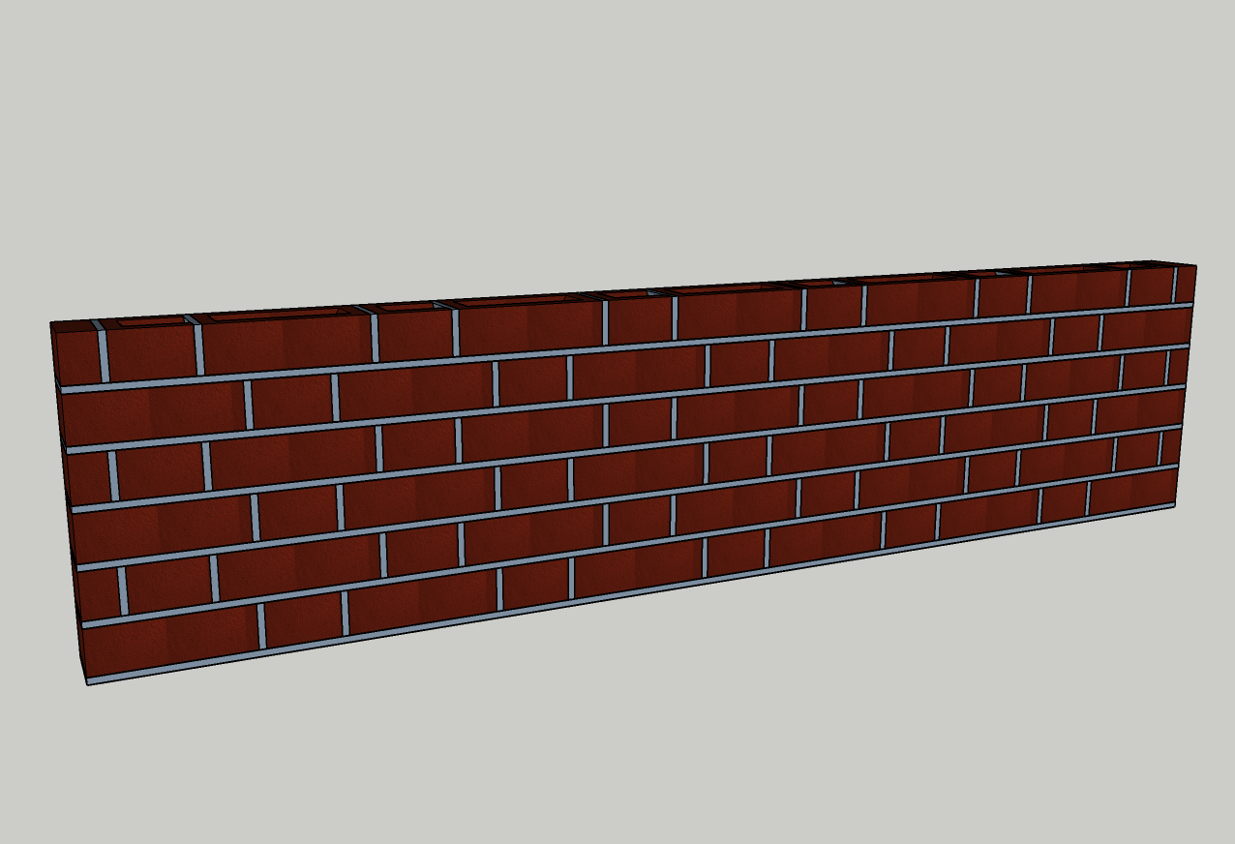
Brick Bonds.
Flemish
Contains full, 1 quarter and 3 quarter bats. First course contains a full brick followed by a half bat, alternated. The second course starts with 1 quarter bat, then half bat then full brick

Slide 27
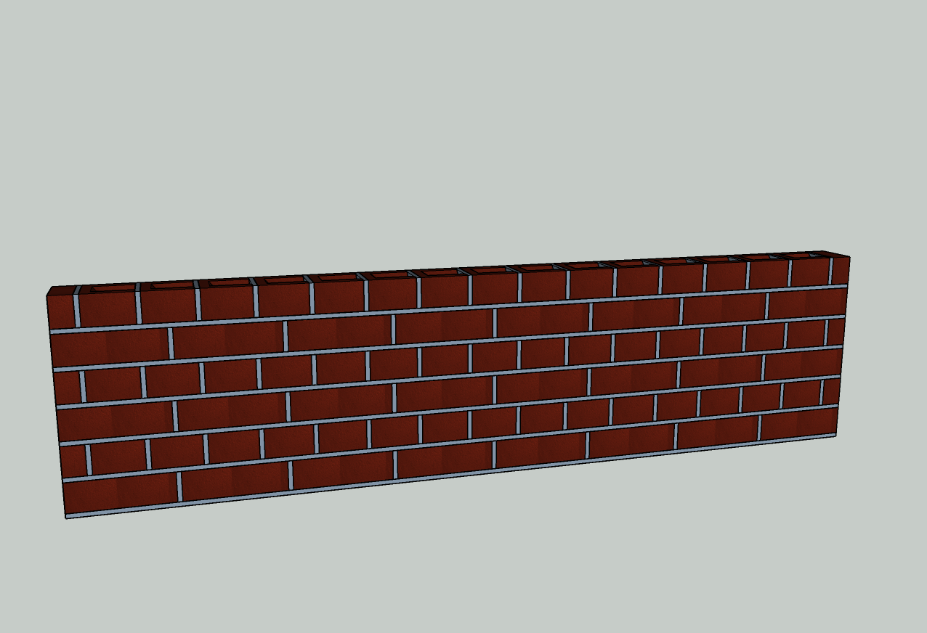
Brick Bonds.
English
Contains full, 1 quarter and 3 quarter bats. First course is series of full bricks, second course starts with 1 quarter bat then a series of half bats.

Slide 28
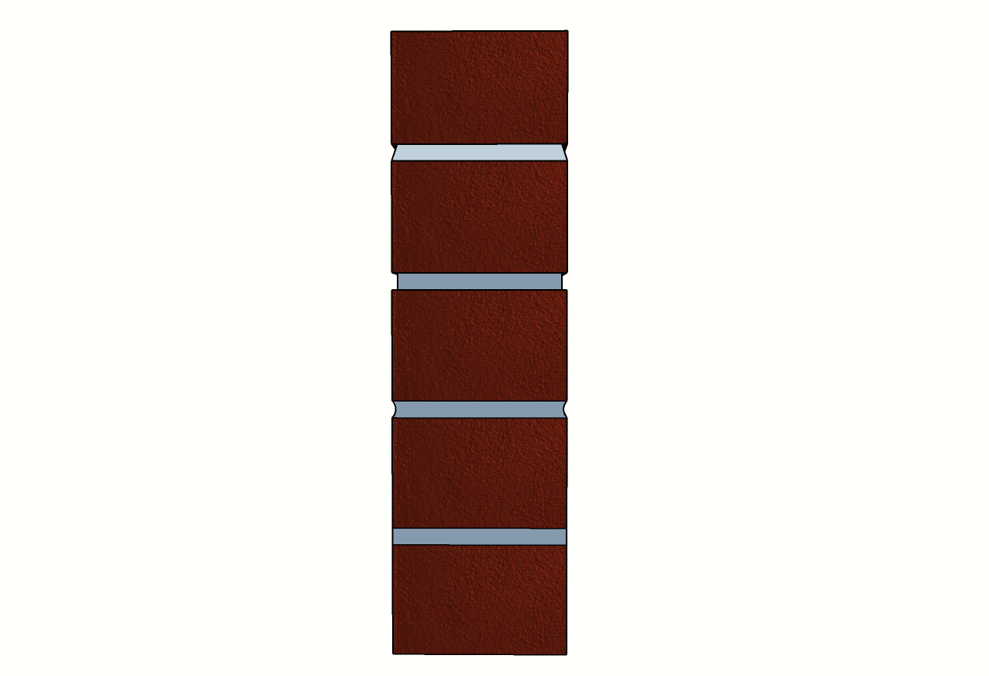
Pointing Styles
Weather Struck
Recessed
Bucket Handle
Flush

Slide 29
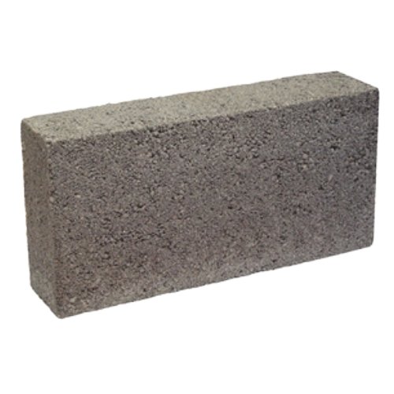
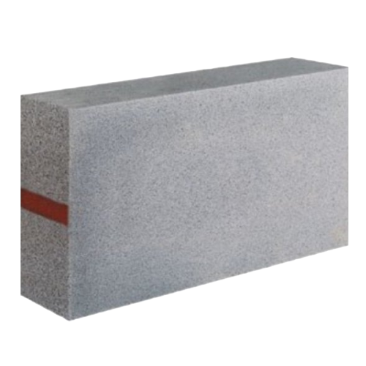
Blocks.
Dense
Block
Lightweight
Block

Slide 30
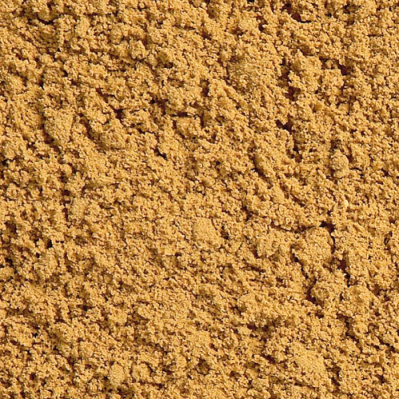
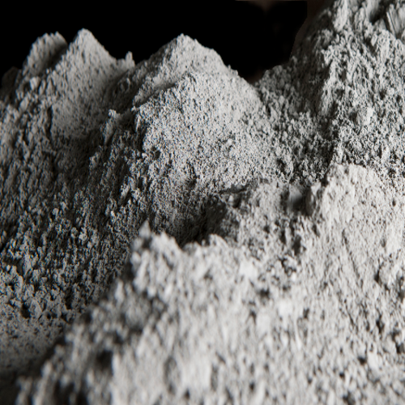
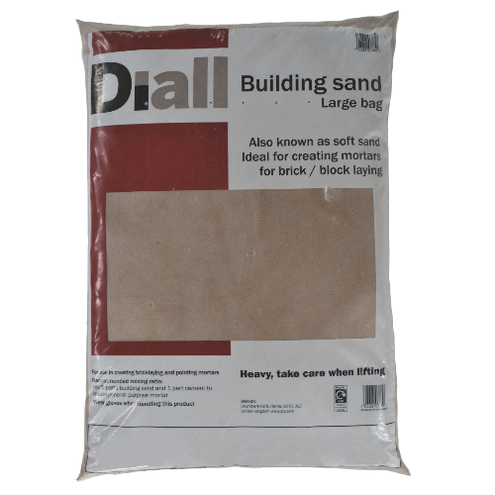
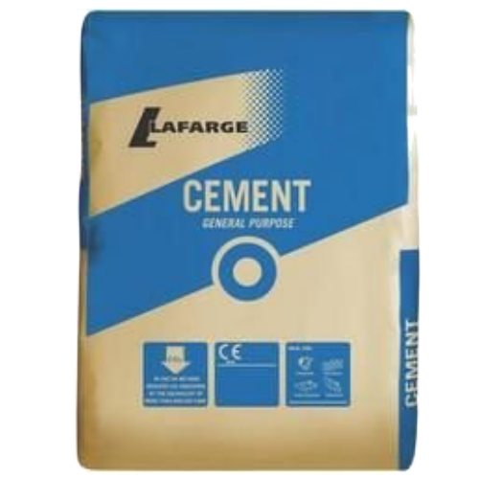
Mortar.
Builders Sand
Cement
Builders sand is a finer grade sand than sharp sand. It has smaller particles and is used mainly with water and cement to make mortar for laying bricks, patio slabs and blocks.
Cement is what’s known as a binder. It sets and hardens and adheres to other materials to bind them together.

Slide 31
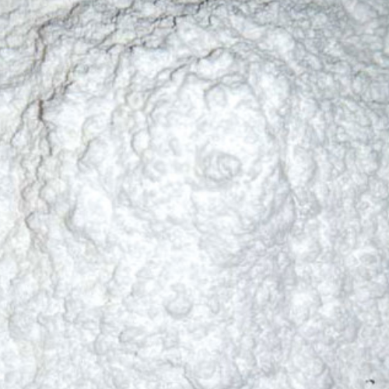

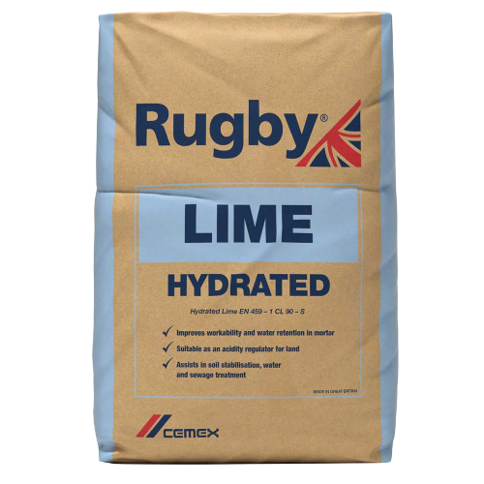
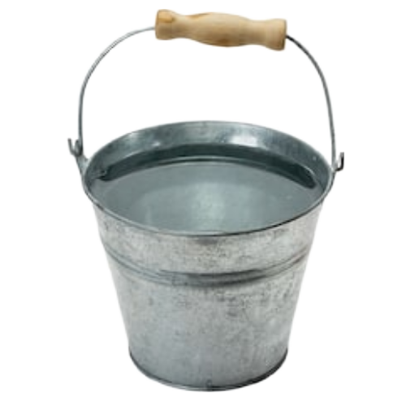
Mortar.
Hydrated Lime
Water
Hydrated lime otherwise known as calcium hydroxide is a white powder. It increases the workability of cement mortar. Hydrated lime is a non-hydraulic lime which harden when drying out. Hydraulic lime sets due to a chemical reaction.
Water or H2O is odorless, transparent, tasteless substance which covers 71% of the earths surface. It is vital to humanity but is also used in many things including construction.

Slide 32
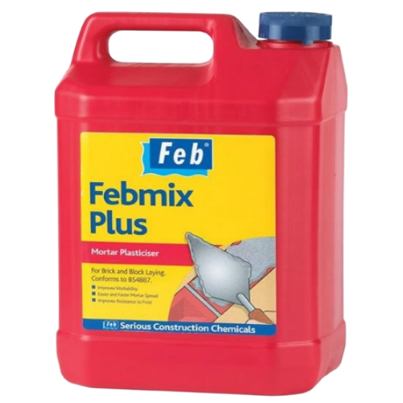
Mortar.
Plasticiser
Plasticiser is an additive used to increase the plasticity or decrease the viscosity of a material.

Slide 33
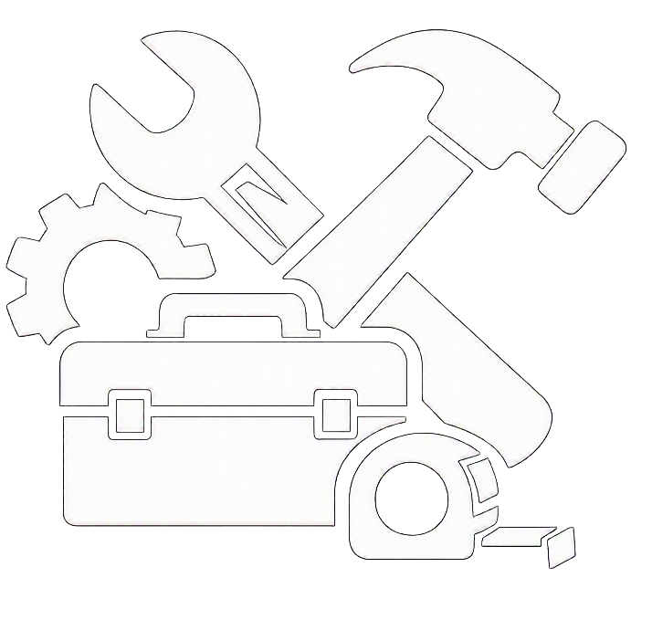
Tools & Equipment

Slide 34
Activities.
Activity:
005.1.3: Tool Master.
Brief:
This activity introduces learners to the core materials used when constructing half‑brick thick walls. Learners will explore the differences between common bricks, facing bricks, and mortar, and understand how each contributes to the structure, strength, and appearance of brickwork.

Slide 35

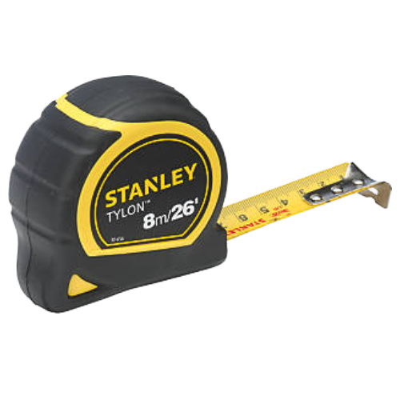
Tools.
Tape Measure
Tape measures sold in the UK often have dual scales for metric and imperial units. Like the American tape measures described above, they also have markings every 16 in (40.6 cm) and 19.2 in (48.8 cm).

Slide 36
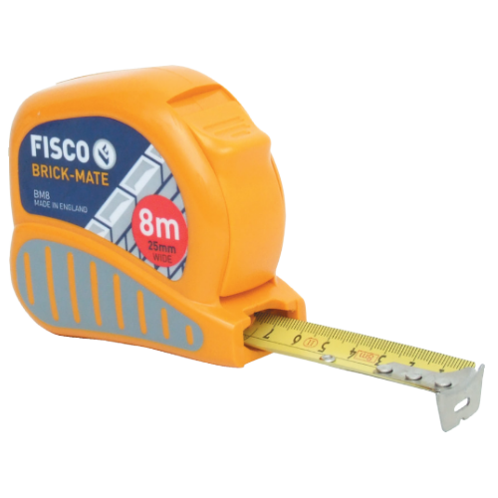
Tools.
Brick Measure
A specialist tape measure designed to aid professional bricklayers in their work. The unique blade design accurately calculates brick and block quantities and course heights, plus there is a conventional metric scale, which is accurate to EC Class I, for general measuring.

Slide 37
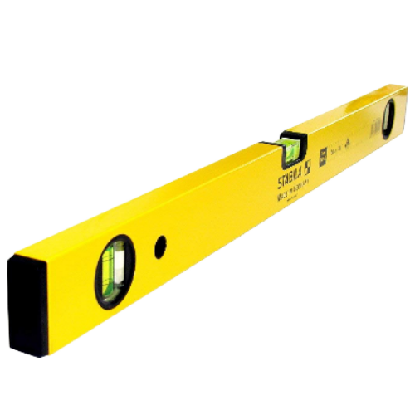
Tools.
Spirit Level
This will be the most expensive part of
the tool kit, thus keeping the bricklayers
work level (horizontal) and plumb
(vertical). These also come in various sizes. The main size for everyday work is nine hundred
millimeters or twelve hundred millimeters.

Slide 38
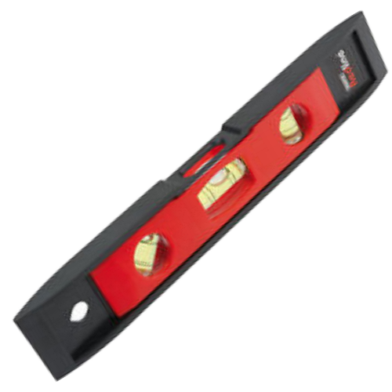
Tools.
Boat Level
Like the Spirit Level above, it has two bubbles, (one for levelling, the other for plumbing) but is smaller. It is very handy for decorative panels and soldier courses.

Slide 39
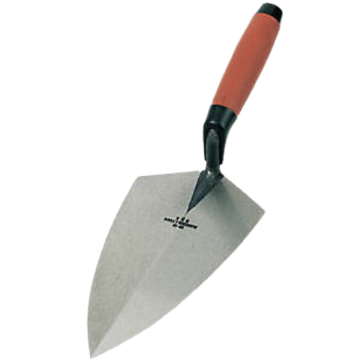
Tools.
Brick Trowel
These came various sizes and shape ranging
between ten and fourteen inches. One side of the
trowel has a more rounded edge, this being for rough
cutting, however, this use is not advised for the
beginner. The measurements are the actual blade
size, the width of trowel also varies and beginners
will find a narrower trowel easier to use. The rounded
side on the trowel makes it suitable for both left and
right-handed operators. When the trowel is not in use for a period, clean it off dry and
apply a light coat of oil to avoid rusting.

Slide 40
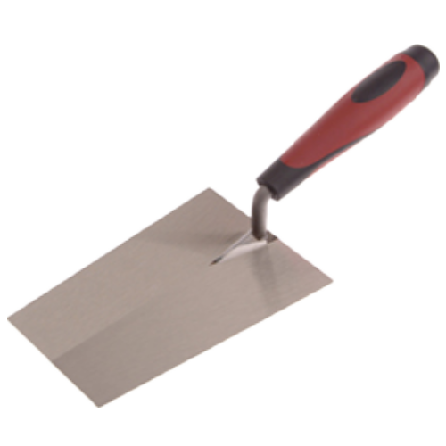
Tools.
Bucket Trowel
Bucket trowels are a wide-bladed tool for scooping mortar from a bucket; it is also good for buttering bricks and smoothing mortar.

Slide 41
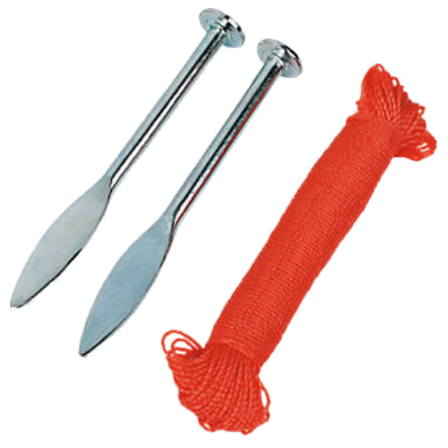
Tools.
Line & Pins
These are used when corners of the building have to be built to run in the bricks between. The pins are tapered at the ends to allow for inserting into joints. It is important that the line is kept free of knots and clean of mortar.

Slide 42
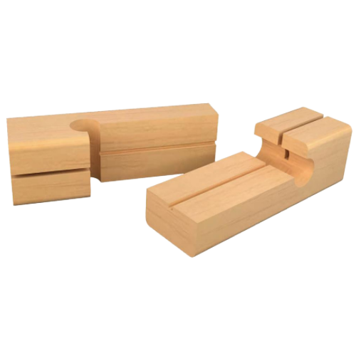
Tools.
Line Blocks
These are used in pairs as an easy method of holding the line up. These are inexpensive as you can make your own.

Slide 43
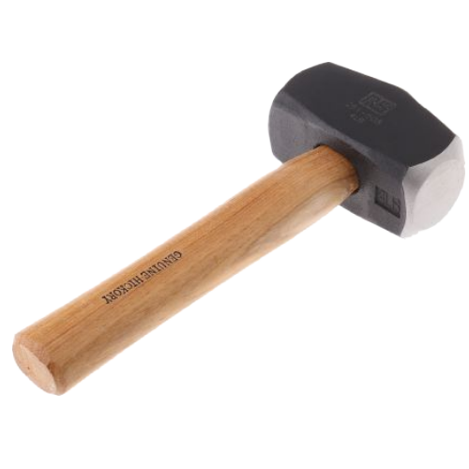
Tools.
Lump Hammer
Used with either a bolster or chisel. It is essential that the head is secure and checked regularly to ensure it never comes loose. Always wear eye protection goggles

Slide 44
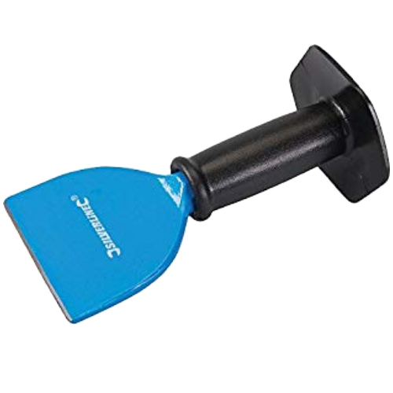
Tools.
Bolster Chisel
Used for cutting bricks. Eye protection must be used at all times it is used. The end should never be allowed to burr over. This is known as a mushroom and can splinter when being hit. The end should be kept free from mushrooms by a grinding wheel which also allows the culling edge to be kept sharp.

Slide 45

Tools.
Cold Chisel
Similar to a bolster but with a smaller blade, used more for cutting into brickwork after it has been laid e.g. for letting in services. Again maintenance and safely procedures should be followed the same as for the bolster.

Slide 46

Tools.
Brick Hammer
A Brick Hammer, also known as a Stonemasons Hammer, has one flat traditional face and a short or long chisel-shaped blade. It can thus be used to chip off edges or small pieces of stone, cut brick or a concrete masonry unit, without using a separate chisel. The chisel blade can also be used to rapidly cut bricks or cinder blocks. This type of hammer is also used by geologists when collecting rock and mineral samples and is one of several types of Geologist's hammer.

Slide 47

Tools.
Scutch Hammer
Scutch hammers have either one or two grooves for holding a scutch comb or drove in exactly the same way as a scutch chisel. Some scutch hammers have two grooves, one on each end of the head. These are known as 'double-ended scutch hammers’.
Scutch hammers, in conjunction with combs and droves, are used for cutting bricks in the same way as scutch chisels, however they are not as precise in their work, due to lack of control when wielding a hammer in comparison to a chisel. This is because the hammer needs more force to wield it than a chisel which needs a hammer/mallet to function.

Slide 48

Tools.
Jointer
Used for putting a finish to the joints in brick work. A half-round joint which is also known as a bucket handle finish. Two types are shown, these can now be bought from shops, but an old pail or bucket handle can be bent to a suitable shape.

Slide 49

Tools.
Hawk
A small hawk is used when pointing a lot and makes it easier to hold the mortar.

Slide 50

Tools.
Builders Square
This is used for setting out the work area and marking and checking right angles.

Slide 51

Tools.
Brick Gauge
Inexpensive as you make it yourself. A length of timber with the vertical spacing of the bricks marked along one edge. Used when working from both ends of a wall to ensure that the courses are equal

Slide 52

Tools.
Spade
A spade is a tool primarily for digging, comprising a blade – typically stunted and less curved than that of a shovel – and a long handle. Early spades were made of riven wood or of animal bones (often shoulder blades).

Slide 53

Equipment.
Brick Carrier
Supersedes the brick hod (original brick carrier). Used for carrying bricks around the work area.

Slide 54

Equipment.
Spot
A spot is a dedicated place for mortar to be temporary placed while the bricklayer lays the bricks and builds the wall.

Slide 55

Equipment.
Hand Brush
Hand brush is a very useful piece of kit for brushing up, cleaning down. Bricklayers will use this type of brush for cleaning down their walls.

Slide 56

Equipment.
Soft Floor Brush
Floor brush used for cleaning down and brushing up.

Slide 57

Equipment.
Tingle Plate
Another less expansive tool but of great use. II is used for holding the line up over long lengths of walling to remove any sagging

Slide 58

Equipment.
Wheelbarrow
Wheelbarrows are used to transport larger amounts of materials to the work area. Sometimes mortar is mixed in a wheelbarrow.

Slide 59

How many?

Slide 60
Brick Size.
Brick Size.
Length: (stretcher) 215mm
Width: (header) 102mm
Height: 65mm
215mm
65mm
102mm

Slide 61


How Many?
Remember to add in the 10mm mortar gap in between bricks
Work out how many bricks would be needed for a wall 3 courses high and 1 meter long.
3 courses high
Wall
1 meter long

Slide 62
Mortar Ingredients.
Builders Sand
Cement
Builders sand is a finer grade sand than sharp sand. It has smaller particles and is used mainly with water and cement to make mortar for laying bricks, patio slabs and blocks.
Cement is what’s known as a binder. It sets and hardens and adheres to other materials to bind them together.

Slide 63
Mortar Ingredients.
Hydrated Lime
Water
Hydrated lime otherwise known as calcium hydroxide is a white powder. It increases the workability of cement mortar. Hydrated lime is a non-hydraulic lime which harden when drying out. Hydraulic lime sets due to a chemical reaction.
Water or H2O is odorless, transparent, tasteless substance which covers 71% of the earths surface. It is vital to humanity but is also used in many things including construction.

Slide 64
Mortar Ratios.
Mortar type | Minimum Compressive Strength | Cement: Sand: hydrates lime ratio | Uses
Type M | 2.500 psi | 3:12:1 | Underground, foundations, retaining walls, driveways
Type S | 1,800 psi | 2:9:1 | Underground, foundations, retaining walls, manholes, sewer walls, brick patios, pavements, and walkways
Type N | 750 psi | 1:6:1 | Above ground, general purpose, interior, exterior, mild load-bearing, chimneys, soft-stone or low-fired brick masonry
Type O | 350 psi | 1:9:2 | Above ground, non-load-bearing, interior
It is important that when mixing mortar that you mix the correct quantities throughout the project, otherwise you run the risk of having different shades of mortar and inconsistencies in strength across the structure.

Slide 65
Calculating Mortar.
Each brick requires the following amounts for the mortar:
0.84kg Cement
1.7kg Sand
0.4ml Plasticiser
This is equal to 2lb of mortar per brick
All you need to do is multiply those amounts by the number of bricks in the wall.

Slide 66

Group Activity.
Mr. Jones is a local man who wants a wall building but he only wants the wall to be 375mm high.
Mr. Jones asks, “how many courses of brick would be needed to get a wall 375mm high?”
If a brick is 65mm and the mortar gap is 10 mm that’s a total of 75mm all we have to do to find out how many courses are needed is to divide the height of the wall by the height of a brick and mortar.
375 divided by 75 = 5 courses
65mm
10mm

Slide 67

Activities.
Activity:
005.1.4: Let’s Build It!.
Brief:
Learners will explore brick quantities for different wall thicknesses and practise calculating brick requirements.

Slide 68
Recap.
In todays session we…
Identified PPE appropriate to building half brick walls
Identified the materials required to build half brick walls
Identified tools and equipment used to build half brick walls
Stated the number of bricks to build a 1m² brick wall
Do you agree?

Slide 69

Any Questions?
If you have any questions why not try and look up the answer online using a search engine and typing in your question, if you can't find your answer then ask your tutor or email them your questions at:
lecturer@college.ac.uk

Slide 70




Resources.
http://www.hse.gov.uk/toolbox/ppe.htm
Personal Protective Equipment At Work Regulation 1992.pdf
https://www.youtube.com/watch?v=q2yAHDkC6Nw
Personal Protective Equipment at Work - A Brief Guide.pdf
https://en.wikipedia.org/wiki/Personal_protective_equipment
https://www.youtube.com/watch?v=GRQ0iDq5UfM
OSHA - Personal Protective Equipment.pdf
https://www.youtube.com/watch?v=XVNMj0ZxZsI

Slide 71

Thank You.
We would like to take this opportunity to thank you for using this material. If you have any questions or suggestion on this or any other learning material produced by Educon please email:
educon.rix@gmail.com

