Slide 1




6219-06 – L1 Ext Certificate Construction Skills/Carpentry & Joinery.
Unit 003: Painting Techniques
101.1: Know how to prepare and paint surfaces.
Painting Techniques.
Lecturer: James Rix
Edited by: Ian Davies

Slide 2

Aim & Objectives.
Aim:
Know how to prepare and paint surfaces
Objectives:
1.1 identify the Personal Protective Equipment (PPE) appropriate to preparing and painting surfaces
1.2 identify the materials required to prepare and paint surfaces
1.3 identify the tools and equipment required to prepare and paint surfaces
1.4 state different types of water-based paints.

Slide 3

PPE

Slide 4

Activities.
Activity:
005.1a – Gear Up & Get Safe!
Brief:
This activity introduces learners to the essential Personal Protective Equipment (PPE) required when constructing half‑brick thick walls.

Slide 5


Types of Personal Protective Equipment (PPE).
Hard Hat
Options:
A range of helmets, hard hats and bump caps
Hazards:
Impact from falling or flying objects, risk of head bumping, hair entanglement
Note:
Some safety helmets incorporate or can be fitted with specially-designed eye or hearing protection. Don’t forget neck protection, eg scarves for use during welding. Do not use head protection if it is damaged – replace it.

Slide 6

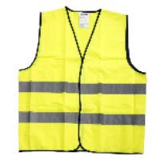
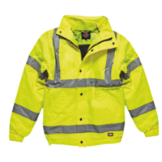
Types of Personal Protective Equipment (PPE).
Hi Vis Vest/Jacket
Options:
Conventional or disposable overalls, boiler suits, specialist protective clothing, eg chain-mail aprons, high-visibility clothing
Hazards:
Temperature extremes, adverse weather, chemical or metal splash, spray from pressure leaks or spray guns, impact or penetration, contaminated dust, excessive wear or entanglement of own clothing.
Note:
The choice of materials includes flame-retardant, anti-static, chain mail, chemically impermeable, and high-visibility. Don’t forget other protection, like safety harnesses or life jackets.

Slide 7

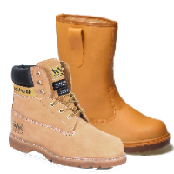
Types of Personal Protective Equipment (PPE).
Safety Boots/Shoes
Options:
Safety boots and shoes with protective toe caps and penetration-resistant mid-sole, gaiters, leggings, spats.
Hazards:
Wet, electrostatic build-up, slipping, cuts and punctures, falling objects, metal and chemical splash, abrasion.
Note: Footwear can have a variety of sole patterns and materials to help prevent slips in different conditions, including oil or chemical-resistant soles. It can also be anti-static, electrically conductive or thermally insulating. It is important that the appropriate footwear is selected for the risks identified

Slide 8

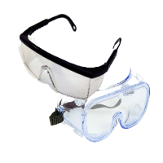
Types of Personal Protective Equipment (PPE).
Safety Specs/Goggles
Options:
Safety spectacles, goggles, face-shields, visors
Hazards:
Chemical or metal splash, dust, projectiles, gas and vapour, radiation
Note:
Make sure the eye protection has the right combination of impact/dust/ splash/molten metal eye protection for the task and fits the user properly.

Slide 9

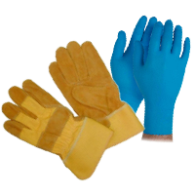
Types of Personal Protective Equipment (PPE).
Safety Gloves
Options:
Gloves, gauntlets, mitts, wrist-cuffs, armlets
Hazards:
Abrasion, temperature extremes, cuts and punctures, impact, chemicals, electric shock, skin infection, disease or contamination.
Note:
Avoid gloves when operating machines such as bench drills where the gloves could get caught. Some materials are quickly penetrated by chemicals so be careful when you are selecting them, see HSE’s skin at work website (www.hse.gov.uk/skin).

Slide 10

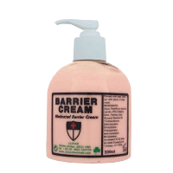
Types of Personal Protective Equipment (PPE).
Barrier Cream
Options:
Barrier Cream
Hazards:
skin infection, disease or contamination
Note:
Barrier creams are unreliable and are no substitute for proper PPE

Slide 11

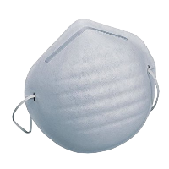
Types of Personal Protective Equipment (PPE).
Dust Mask
Options:
Disposable filtering face-piece or respirator
Hazards:
Dust
Note:
The right type of respirator filter must be used as each is effective for only a limited range of substances.

Slide 12

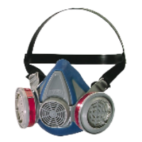
Types of Personal Protective Equipment (PPE).
Respirator
Options:
half- or full-face respirators, airfed helmets, breathing apparatus.
Hazards:
Dust, vapour, gas, oxygen-deficient atmospheres
Note:
The right type of respirator filter must be used as each is effective for only a limited range of substances. Where there is a shortage of oxygen or any danger of losing consciousness due to exposure to high levels of harmful fumes, only use breathing apparatus – never use a filtering cartridge. Filters only have a limited life; when replacing them or any other part, check with the manufacturer’s guidance and ensure the correct replacement part is used

Slide 13


Types of Personal Protective Equipment (PPE).
Ear Defenders
Options:
Foam earplugs, wax balls, ear defenders, Silicon Plugs, Universal Earplugs, otoplasties
Hazards:
Damage to hearing, hearing loss, deafness
Note:
Should be used when noise level is 80 db or more. It is important that the correct type of ear protection is used for the noise level you are working in. This type of PPE is not covered under Personal Protective Equipment At Work Regulations 1992/2002 as it has its own regulation. The Control of Noise at Work Regulations 2005

Slide 14

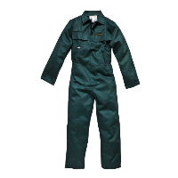
Types of Personal Protective Equipment (PPE).
Overalls
Options:
Conventional or disposable overalls, boiler suits, specialist protective clothing, eg chain-mail aprons
Hazards:
Temperature extremes, adverse weather, chemical or metal splash, spray from pressure leaks or spray guns, impact or penetration, contaminated dust, excessive wear or entanglement of own clothing.
Note:
The choice of materials includes flame-retardant, anti-static, chain mail, chemically impermeable, and high-visibility. Don’t forget other protection, like safety harnesses or life jackets

Slide 15

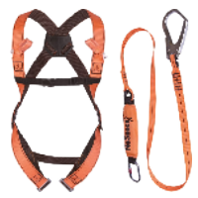
Types of Personal Protective Equipment (PPE).
Harness
Options:
Harness
Hazards:
Falling from height
Note:
This is not covered under the Personal protection Equipment At Work 1992/2002, it has its own regulation. Working at Height regulations 2005

Slide 16


Conformite Europeenne.
CE Marking.
It is extremely important when buying PPE that you make sure
that this symbol is displayed on the item being bought. This marking
is covered under the European Directive 89/686/EEC and ensures that the quality of the PPE is of acceptable standards. Always buy CE marked PPE.
European Economic Area

Slide 17

Materials.

Slide 18


Activities.
Activity:
003.1.1: Prep it like a Pro!
Brief:
This activity introduces learners to the core materials used when preparing and painting surfaces in professional decorating. Learners will explore each material, handle samples, and identify its purpose within the preparation process. This builds foundational knowledge required for safe, effective painting techniques.

Slide 19
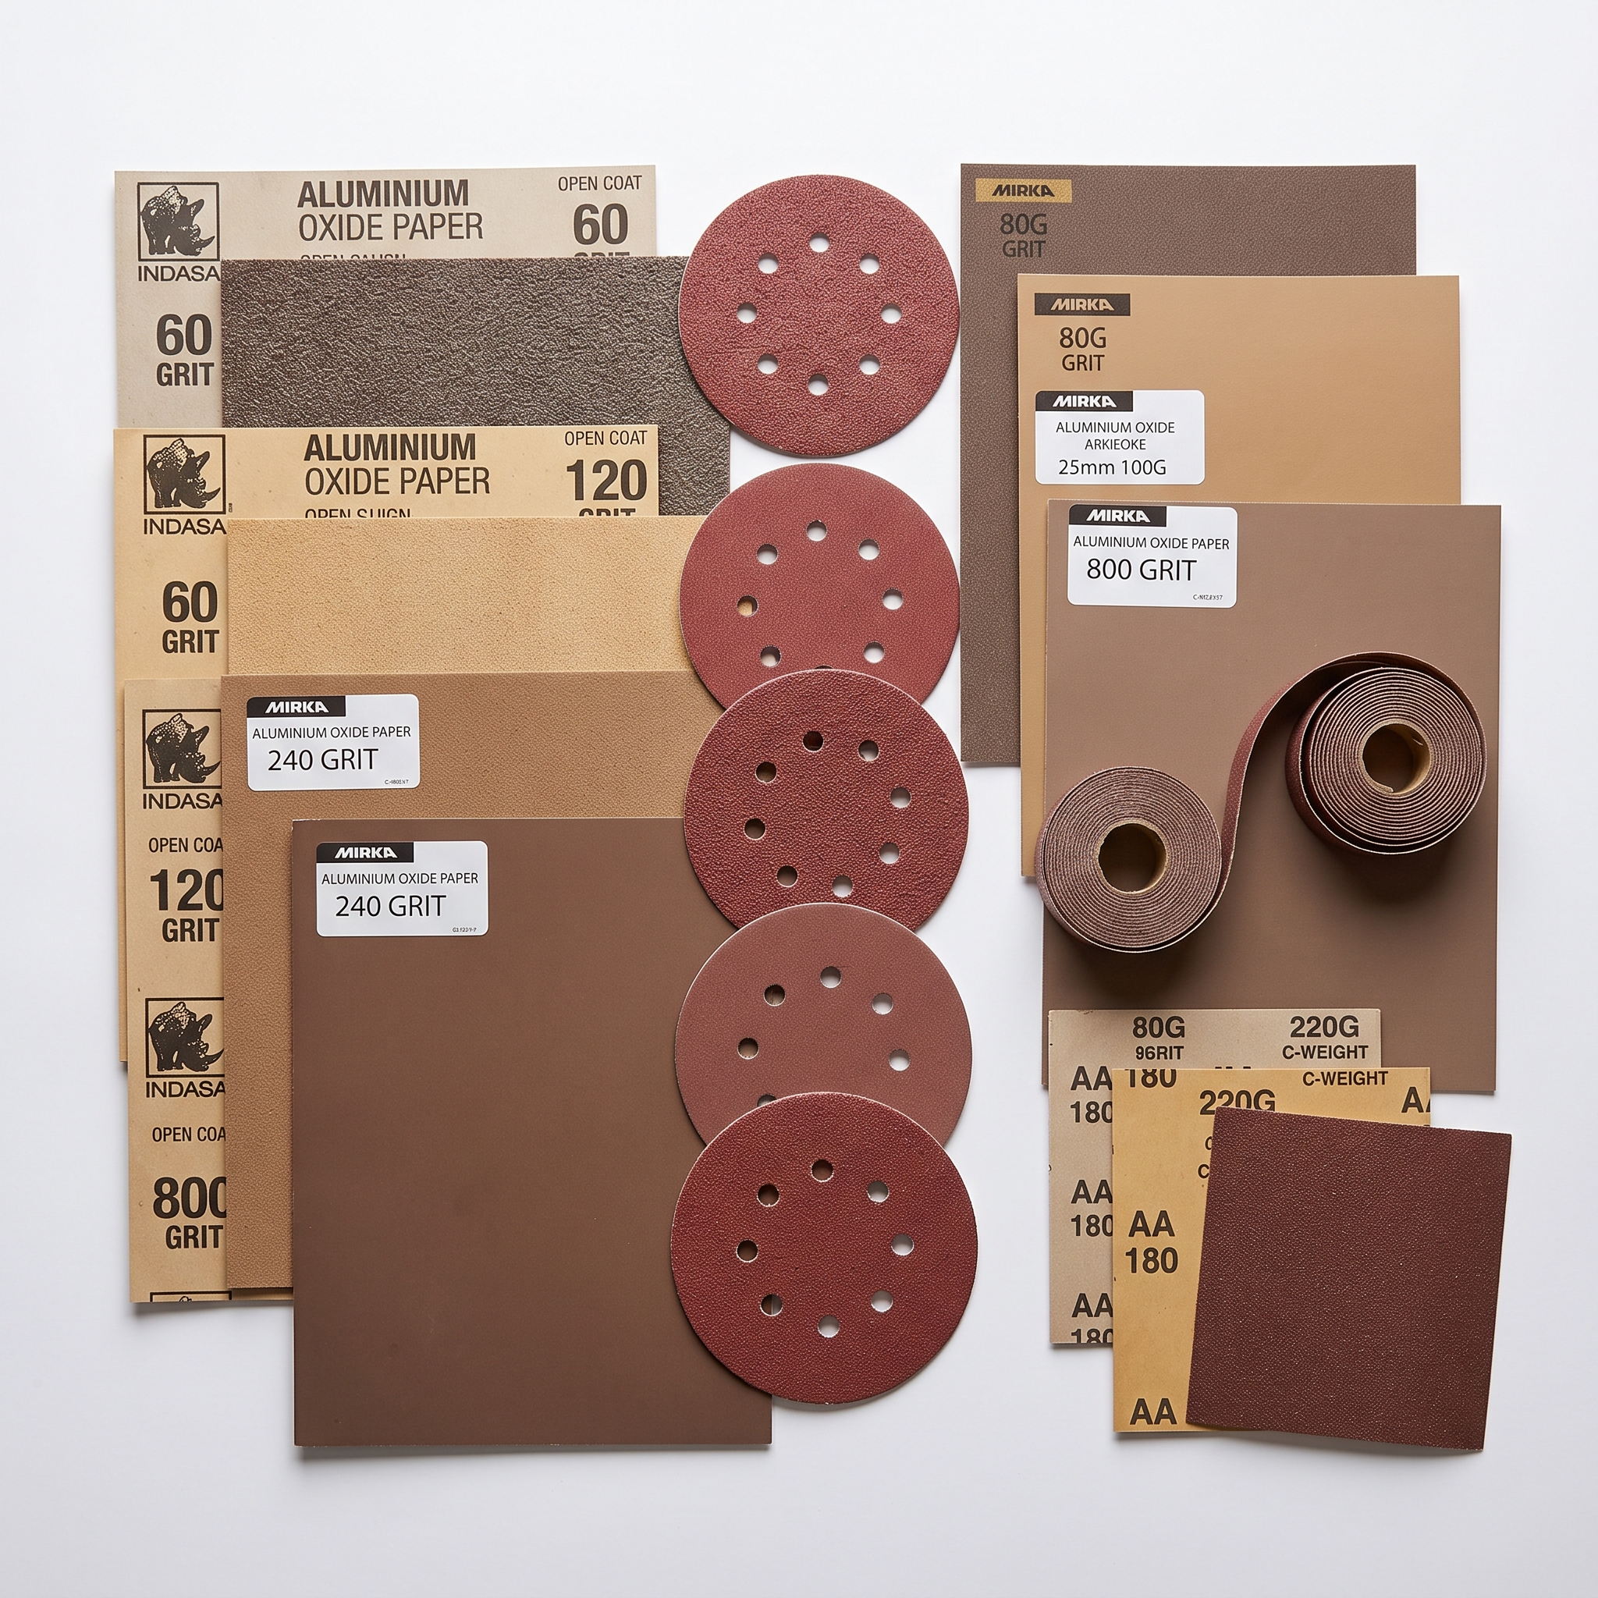
Aluminium Oxide Paper.
Aluminium Oxide Paper is a durable abrasive material widely used in painting and decorating for surface preparation. It consists of a tough backing coated with aluminium oxide grains, which provide excellent cutting power and long-lasting performance. This paper is ideal for sanding wood, metal, and painted surfaces, helping to smooth imperfections and create a clean, even base before applying new coatings. Its resistance to wear and clogging makes it suitable for both hand and machine sanding, ensuring consistent results across a range of decorating tasks.

Slide 20
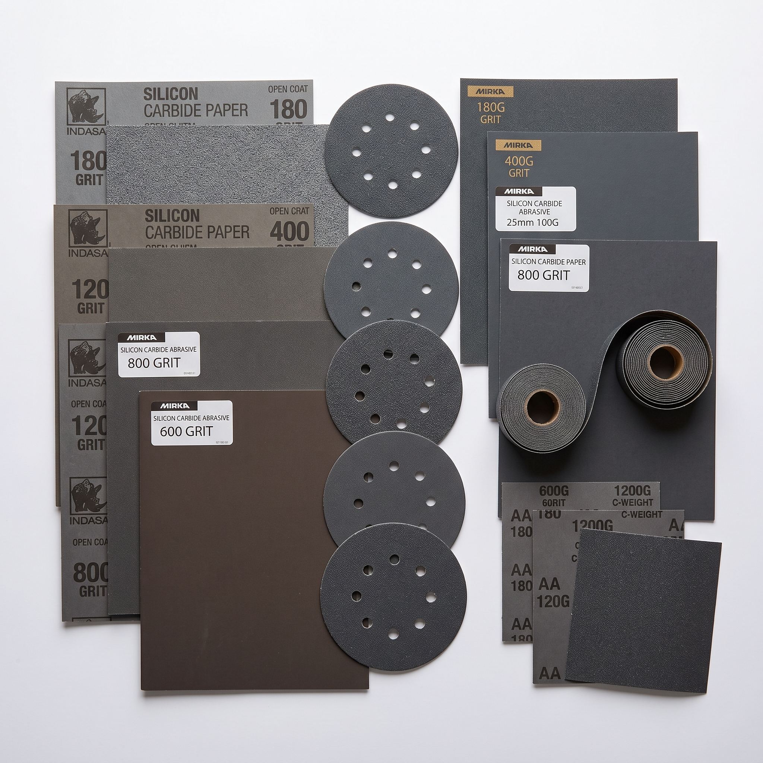
Silicon Carbide Paper.
Silicon Carbide Paper is a high‑performance sanding material known for its sharp, hard abrasive grains that deliver a fine, smooth finish. It’s commonly used for polishing metals, plastics, and painted surfaces, as well as for wet sanding applications where water helps reduce clogging and heat buildup. The silicon carbide particles cut quickly and cleanly, making this paper ideal for achieving precise surface preparation before painting or varnishing. Its flexibility and consistent grit distribution ensure professional results across both manual and machine sanding tasks.

Slide 21
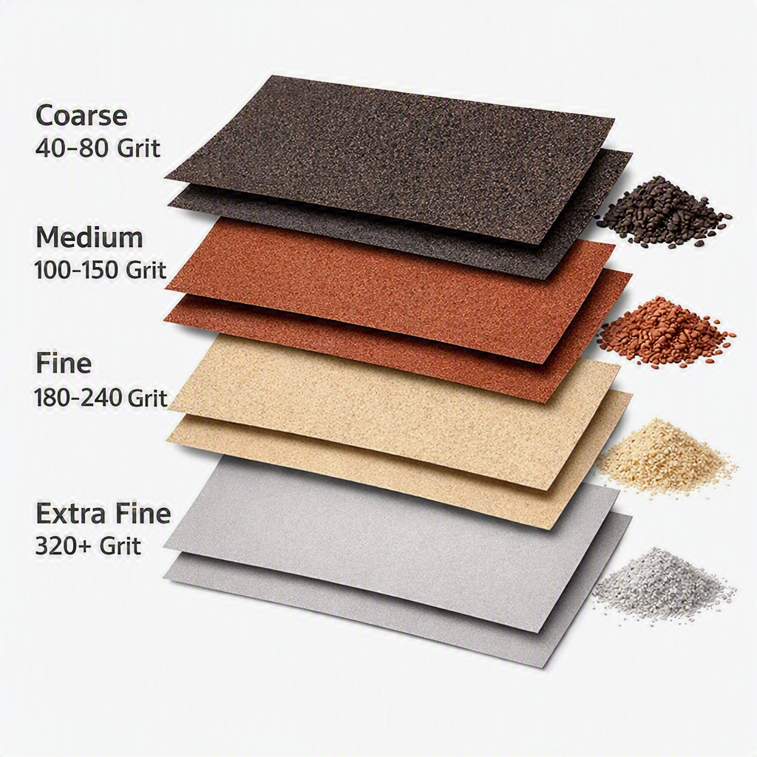
Abrasive Grits
Abrasive paper grits refer to the size of the abrasive particles bonded to the paper, and they play a crucial role in achieving the right surface finish during painting and decorating. Lower grits, such as 40–80, are coarse and designed for heavy material removal, making them ideal for stripping old paint or shaping rough timber. Medium grits, typically 100–150, are used for general sanding tasks, smoothing surfaces, and preparing wood or filler before priming. Fine grits, ranging from 180–240, help refine the surface further, removing minor imperfections and ensuring a clean, even finish. Extra‑fine grits, 320 and above, are used for final sanding between coats of paint or varnish, producing a smooth, professional-quality surface ready for finishing.

Slide 22
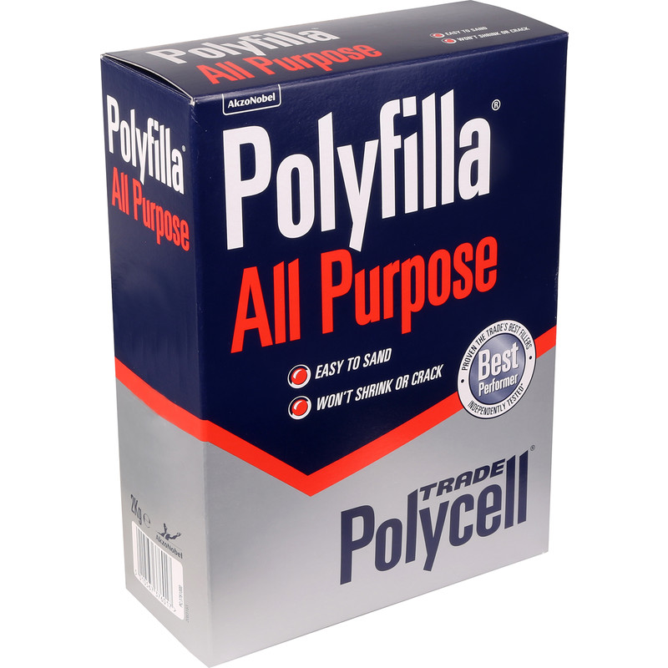
Cellulose Filler.
Cellulose Filler is a versatile material used in painting and decorating to fill small cracks, holes, and surface imperfections before applying paint or wallpaper. Made primarily from natural cellulose fibres, it offers excellent adhesion and flexibility, allowing it to bond well with wood, plaster, and masonry surfaces. Once applied, cellulose filler dries to a smooth, sandable finish that can be easily shaped or refined to match the surrounding texture. Its quick-drying and low-shrink properties make it ideal for both interior and exterior use, providing a reliable base for achieving a flawless, professional-quality finish.

Slide 23
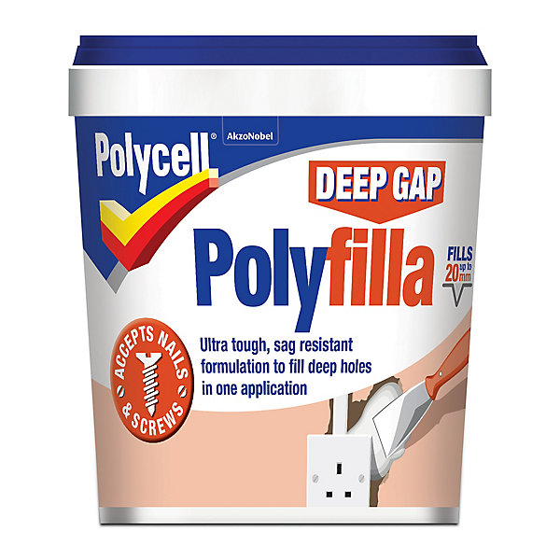
Ready Mixed Filler.
Ready Mixed Fillers are convenient, pre-prepared compounds used in painting and decorating to repair cracks, holes, and surface imperfections without the need for manual mixing. They come ready to use straight from the tub, offering consistent texture and reliable adhesion to surfaces such as plaster, wood, and masonry. These fillers dry to a smooth, hard finish that can be easily sanded and painted over, making them ideal for quick repairs and professional results. Their ease of application and minimal shrinkage make them a popular choice for decorators seeking efficiency and a flawless surface before finishing.

Slide 24
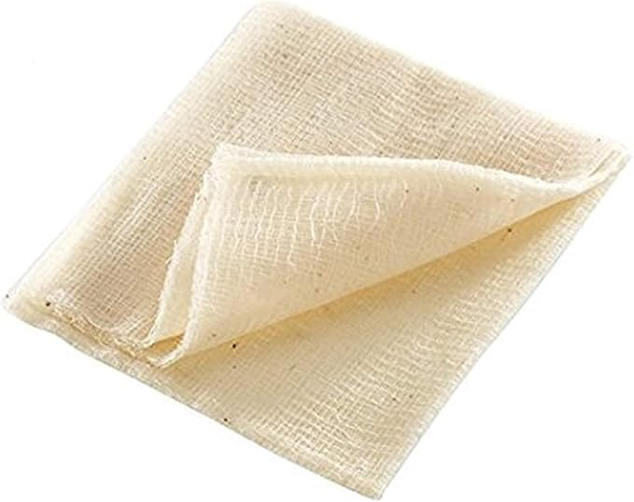
Tack Cloth.
Tack Cloth is a lightly adhesive, lint‑free cloth used in painting and decorating to remove fine dust, sanding residue, and loose particles from surfaces before applying paint, varnish, or primer. Its slightly sticky texture lifts debris without leaving marks or moisture, ensuring the surface is perfectly clean and ready for finishing. Tack cloths are especially valuable after sanding, where even tiny particles can affect the smoothness and appearance of the final coat. By providing a dust‑free surface, they help decorators achieve a flawless, professional finish every time.

Slide 25
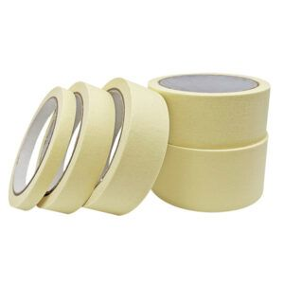
Masking Tape.
Masking Tape is an essential tool in painting and decorating, used to create clean, sharp edges and protect surfaces from unwanted paint. Made with a low‑tack adhesive, it sticks securely without damaging underlying materials, making it ideal for use on walls, trim, glass, and finished wood. Traditional masking tapes are designed for general-purpose work, but modern innovations—such as Frog Tape and other advanced painter’s tapes—offer superior performance. These newer tapes use special paint‑block technology that reacts with latex paint to form a micro‑barrier, preventing bleed‑through and ensuring crisp, professional lines. Available in various widths and adhesion levels, masking tapes help decorators achieve precise results while speeding up preparation and reducing cleanup.

Slide 26
Tools & Equipment.

Slide 27

Activities.
Activity:
003.1.3: Tools of the Trade
Brief:
This activity introduces learners to the essential tools used in professional painting and decorating. Students will explore each tool, understand its purpose, and learn how it contributes to high‑quality surface preparation and finishing.

Slide 28
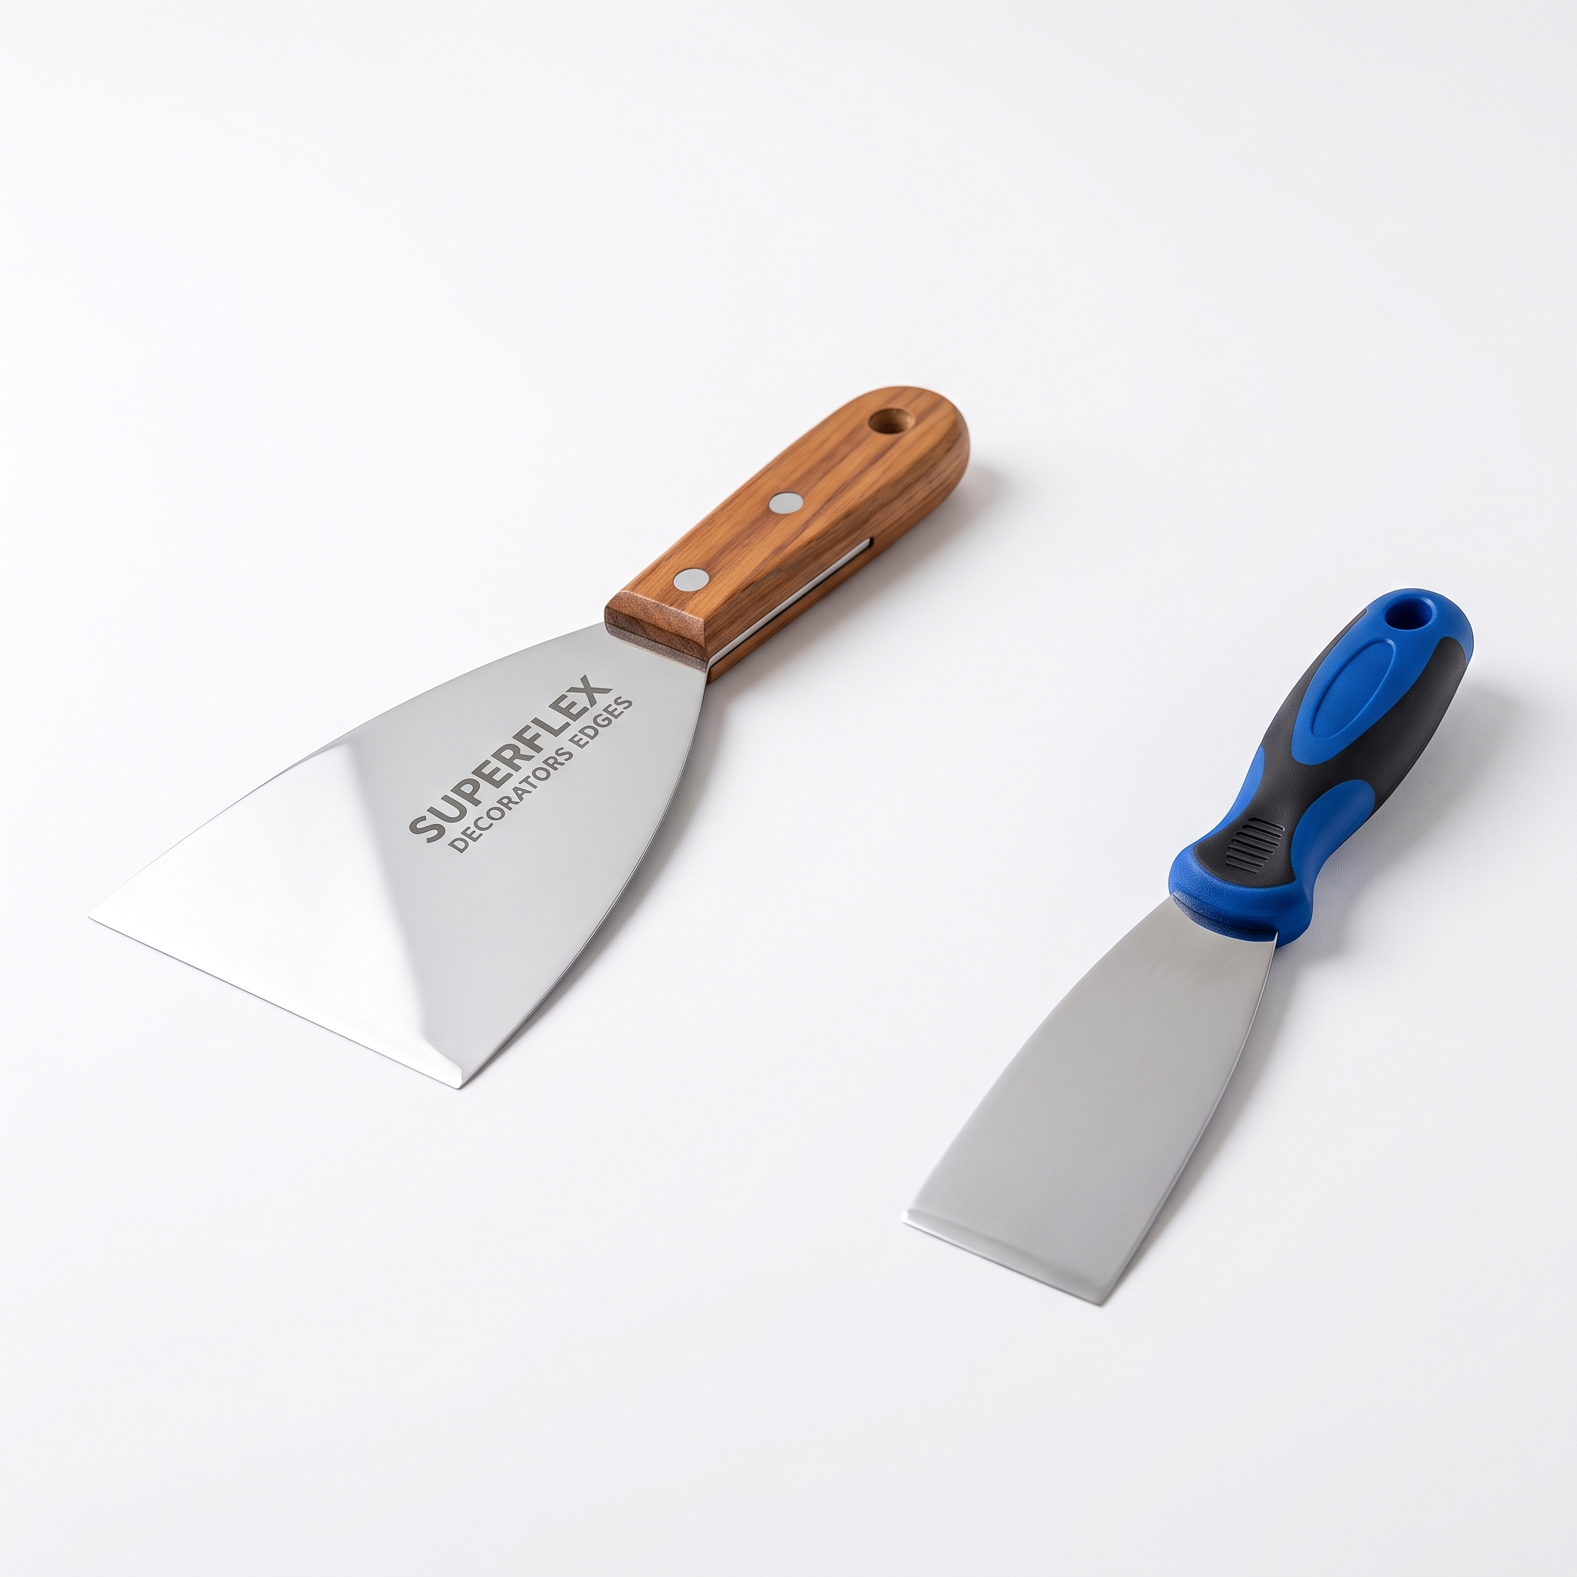
Filler Knives.
Flexible filling knives are designed to apply filler smoothly across surfaces, especially over small cracks and imperfections. Their thin, pliable blades allow decorators to spread filler evenly without leaving ridges, ensuring a seamless finish once sanded. They’re essential for achieving a professional, level surface before painting.

Slide 29
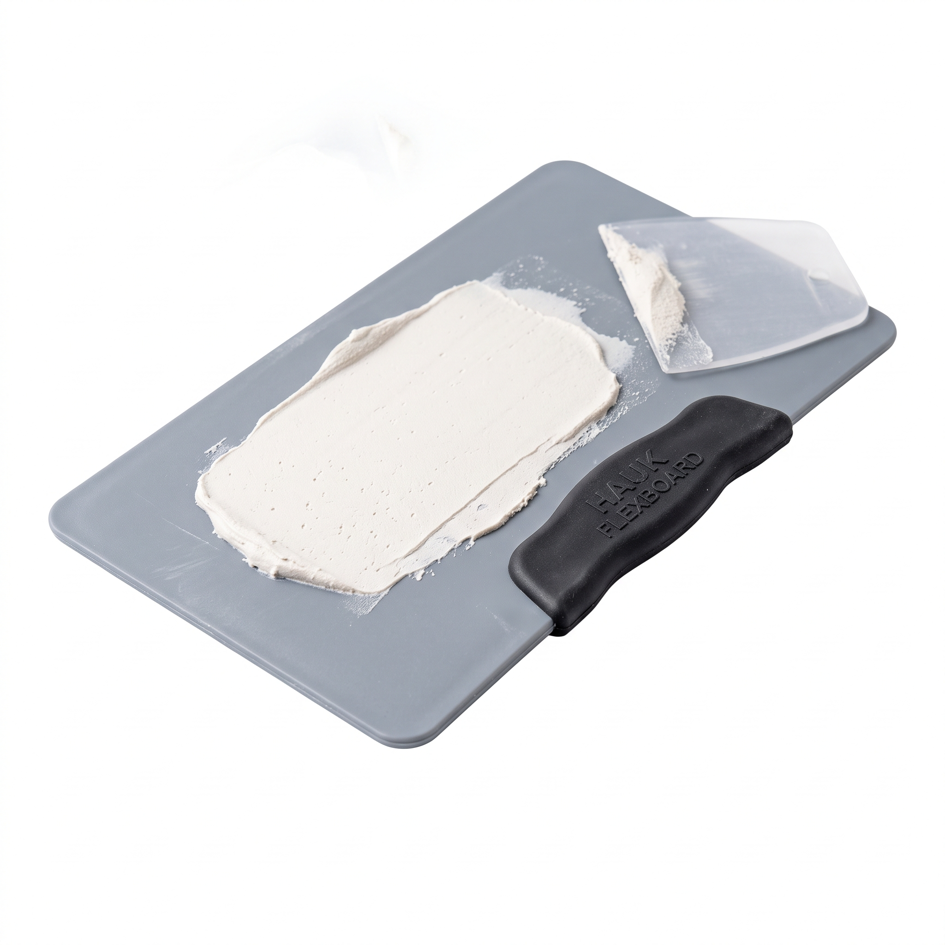
Filling Board.
A filling board provides a clean, flat surface for mixing and holding filler during application. It helps control the amount of product used and keeps the filler workable while preventing contamination. Using a filling board promotes efficiency and cleanliness in the preparation process.

Slide 30
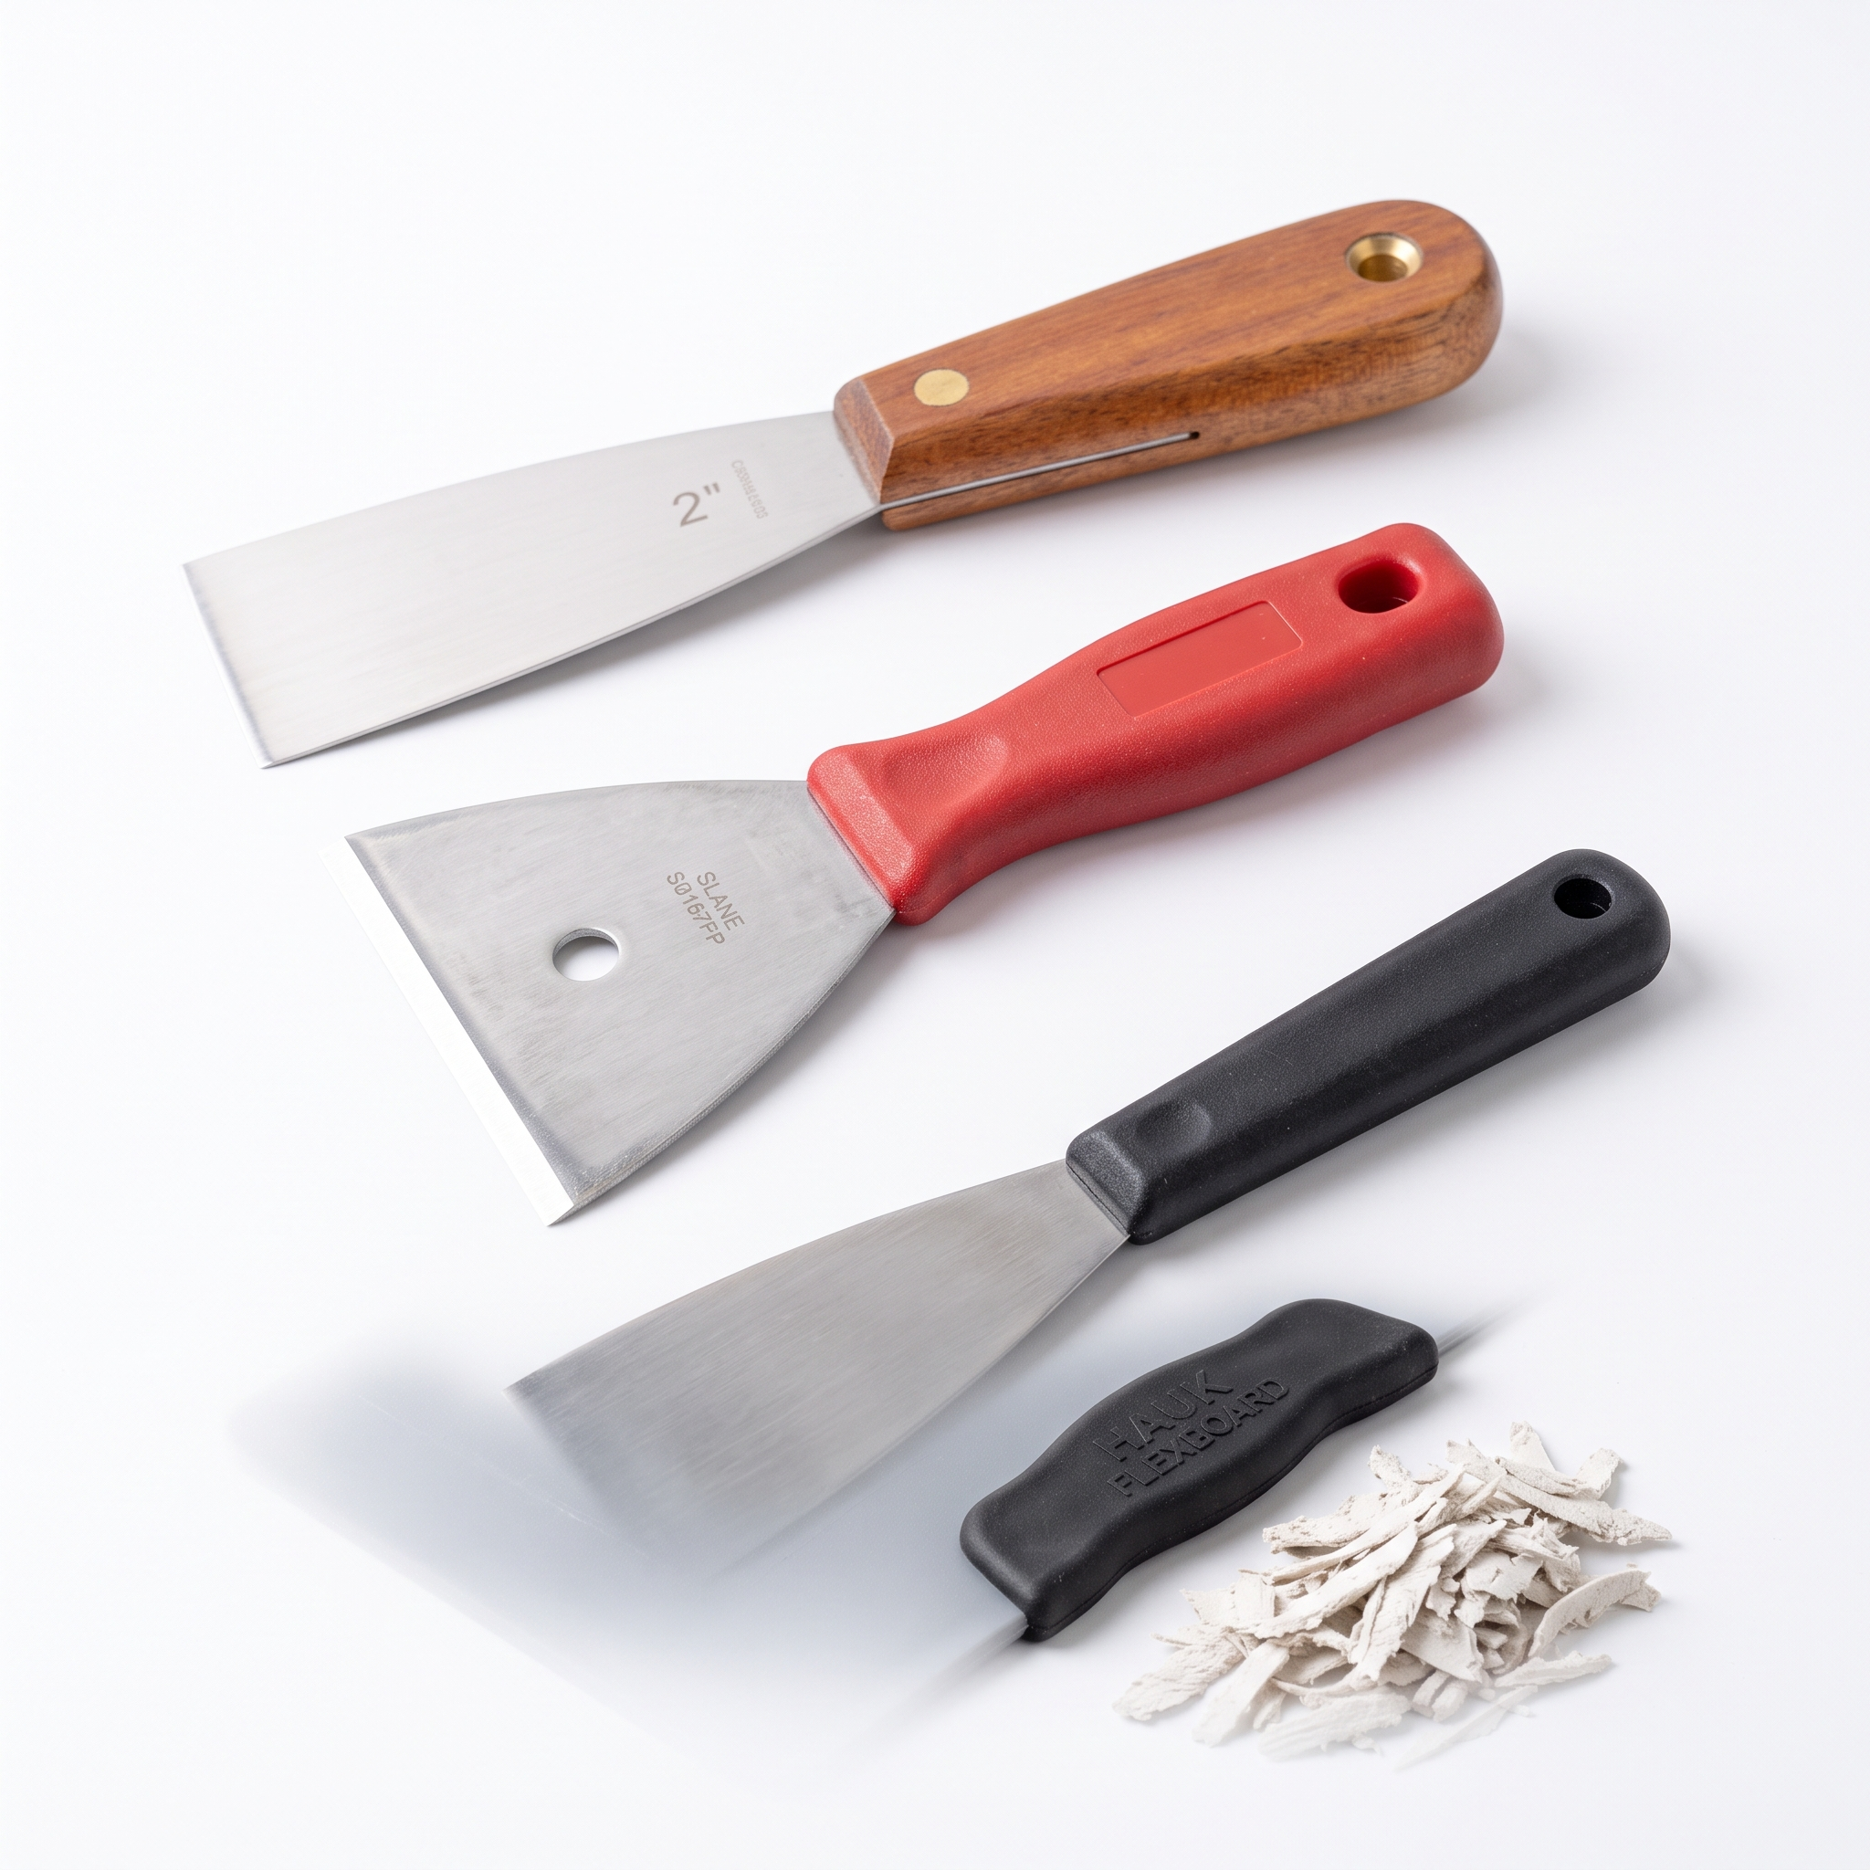
Scrapers.
Scrapers are used to remove loose paint, wallpaper, or debris from surfaces before decorating. Available in various widths and edge types, they help ensure that surfaces are smooth and free from imperfections. Proper use of scrapers prevents paint failure and improves adhesion.

Slide 31
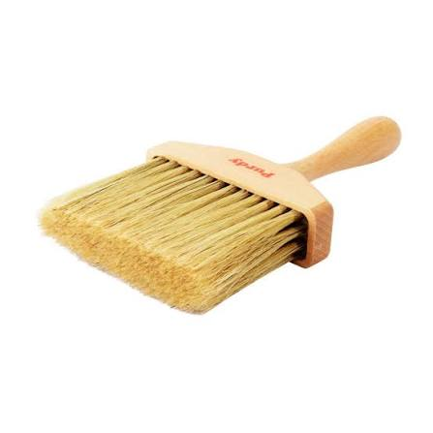
Dust Brush.
A dust brush is used to sweep away sanding residue, filler dust, and other particles before painting. Keeping surfaces dust-free is vital for achieving a flawless finish, as leftover debris can cause paint defects or uneven coverage. It’s a simple but crucial tool in surface preparation.

Slide 32
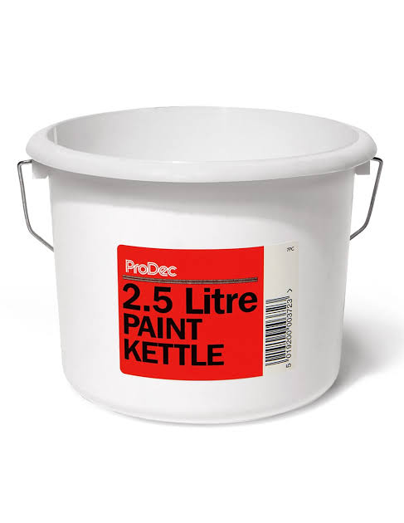
Paint Kettles.
Paint kettles are small, portable containers used to hold manageable amounts of paint during application. They make it easier to work efficiently on ladders or in confined spaces and reduce the risk of spills. Many include handles and pouring lips for convenience and control.

Slide 33
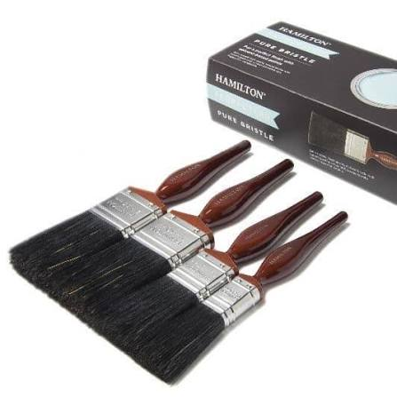
Pure Bristle Brushes.
Pure bristle brushes are ideal for oil-based paints, offering excellent paint pickup and smooth flow. Synthetic brushes, made from nylon or polyester, are better suited for water-based paints and resist swelling. Choosing the right brush type ensures consistent coverage and professional results.

Slide 34
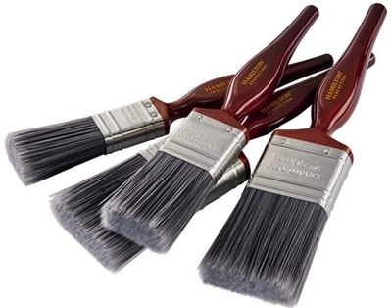
Synthetic Brushes.
Pure bristle brushes are ideal for oil-based paints, offering excellent paint pickup and smooth flow. Synthetic brushes, made from nylon or polyester, are better suited for water-based paints and resist swelling. Choosing the right brush type ensures consistent coverage and professional results.

Slide 35
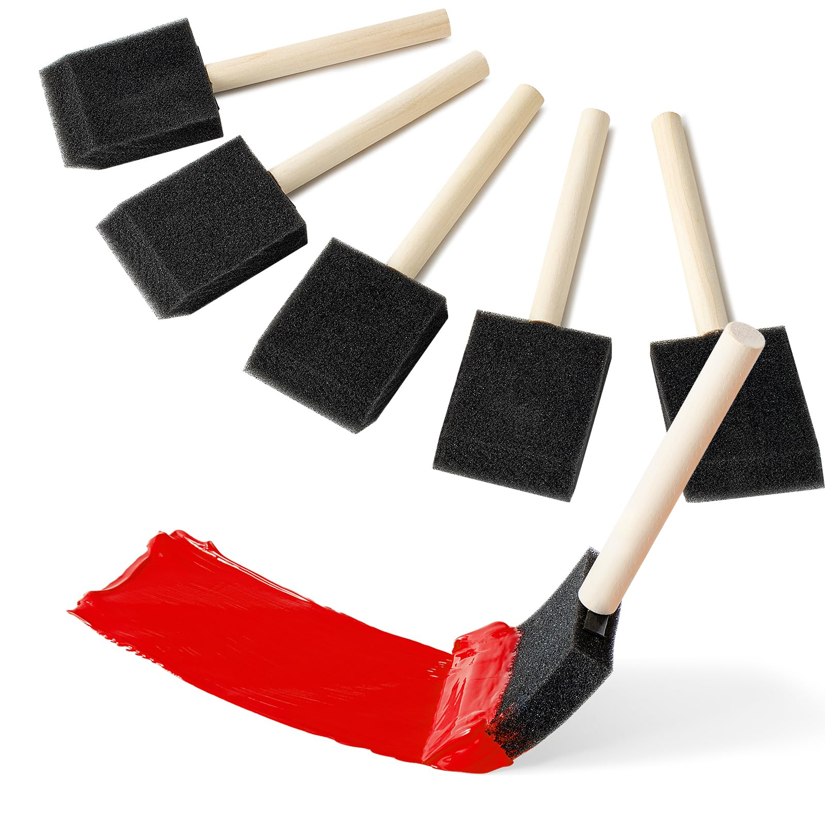
Paint Pads.
Foam brushes are lightweight applicators designed for smooth, even coverage on small or detailed surfaces. Their soft foam heads hold paint well and release it without leaving bristle marks, making them ideal for applying varnish, stain, or gloss on trim, mouldings, and furniture. Because they create a clean finish and reduce the risk of visible brush strokes, foam brushes are especially useful for touch‑ups and precision work. They’re inexpensive, easy to control, and perfect for learners practising fine application techniques.

Slide 36
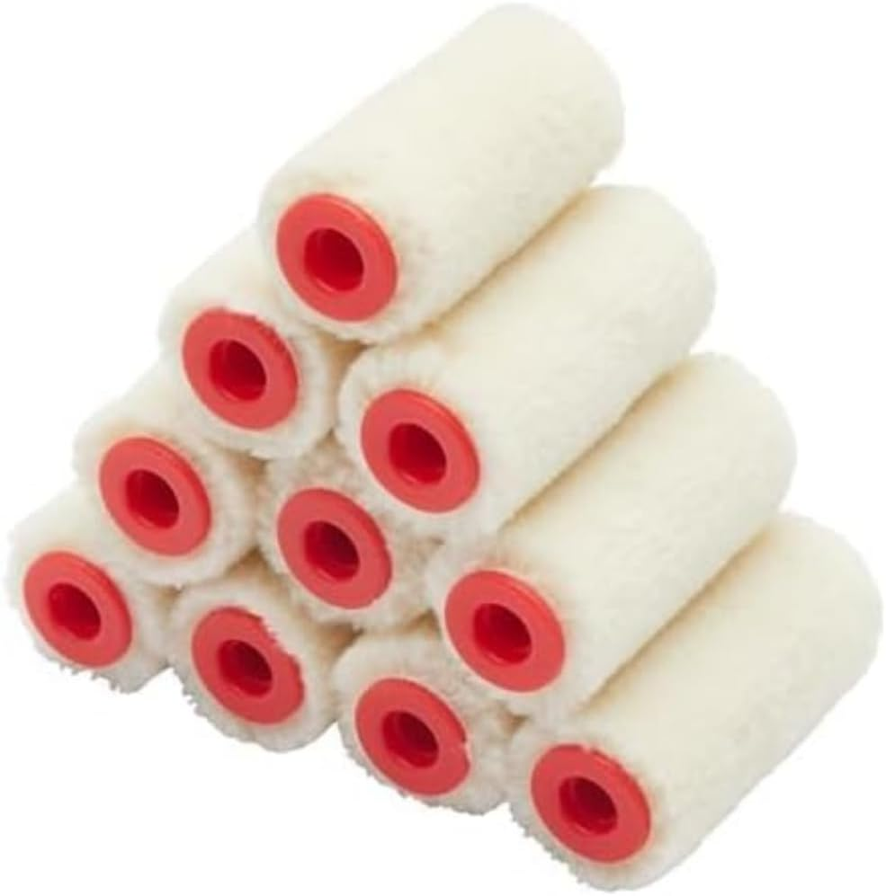
Mohair Rollers.
Mohair rollers are designed for applying ultra‑smooth finishes on doors, trim, and other fine surfaces where a high‑quality result is essential. Made from tightly woven mohair fibres, they hold paint evenly and release it in a controlled, consistent layer, reducing the risk of roller marks or texture. Their durability makes them ideal for use with gloss, varnish, and other high‑sheen coatings, and they excel on hard, flat surfaces where precision matters. Mohair rollers help decorators achieve a professional, flawless finish with minimal effort.

Slide 37
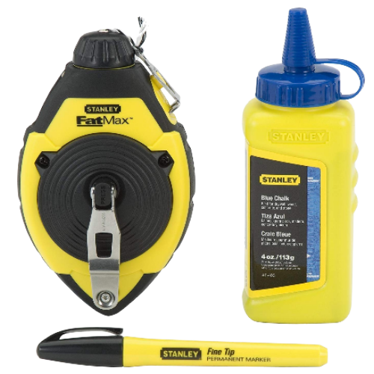
Chalk Line & Reel.
A chalk line tool marks straight guidelines across large surfaces, helping decorators align patterns, borders, or masking accurately. It’s especially useful for ensuring symmetry and precision in layout work. The chalk can be easily wiped away after painting.

Slide 38
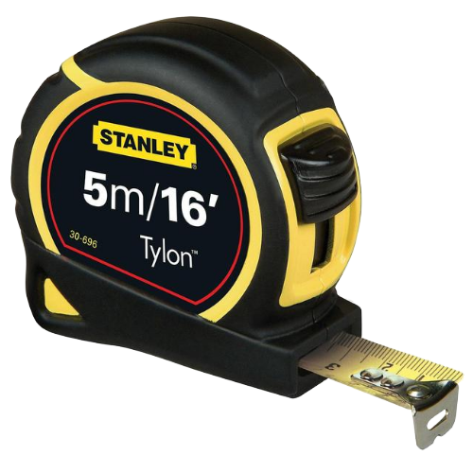
Measuring Tape.
A measuring tape is essential for accurate measurement of surfaces, materials, and layouts. It ensures that cuts, markings, and applications are precise, reducing waste and improving overall workmanship. Reliable measurement is the foundation of professional decorating.

Slide 39
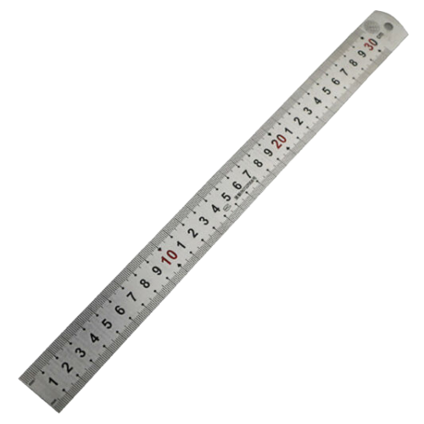
Steel Rule
A steel rule provides rigid, accurate measurement for smaller tasks such as cutting wallpaper or marking filler boards. Its straight edge also serves as a guide for trimming and drawing lines. It’s a durable, precision tool used throughout the decorating process.

Slide 40
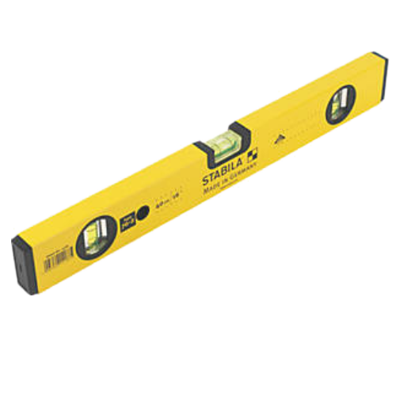
Spirit Level.
Spirit levels ensure surfaces, lines, and fixtures are perfectly horizontal or vertical. They’re vital for achieving professional alignment when hanging wallpaper, fitting trims, or marking paint boundaries. Using a level prevents visual errors and maintains high-quality standards.

Slide 41
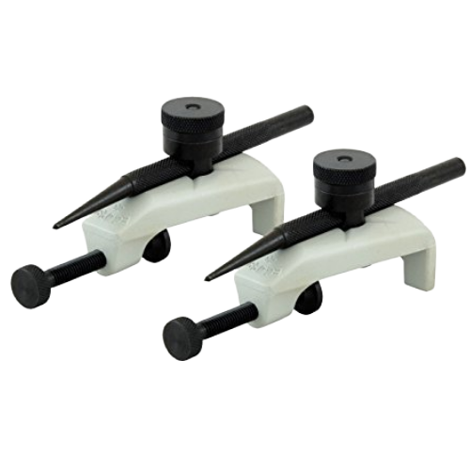
Trammels.
Trammels are adjustable tools used to draw large circles or arcs, often for decorative or layout work. They attach to a beam or bar and allow precise marking over wide areas. In decorating, they’re useful for creating curved designs or measuring consistent radii on walls and ceilings.

Slide 42
Water Based Paints

Slide 43

Activities.
Activity:
003.1.4: Wet Edge Wonders
Brief:
This activity introduces learners to the range of water‑based paints used in professional painting and decorating. Students will explore each type, understand its properties, and learn how water‑based formulations improve safety, environmental performance, and ease of use.

Slide 44

Water Based Paints.
Water‑based paints are modern coatings that use water as the main liquid that carries the pigment and binder, rather than solvents like those found in traditional oil‑based paints. Because water is the primary carrier, these paints dry quickly, produce very low odour, and are much safer to use in indoor environments. The water evaporates during drying, leaving behind the colour and protective film. Their water‑based formulation also makes tools easier to clean, reduces harmful emissions, and provides a more environmentally friendly option for decorators. This is why most primers, matt, silk, soft sheen, acrylic eggshell, and even many gloss paints are now made as water‑based products.

Slide 45
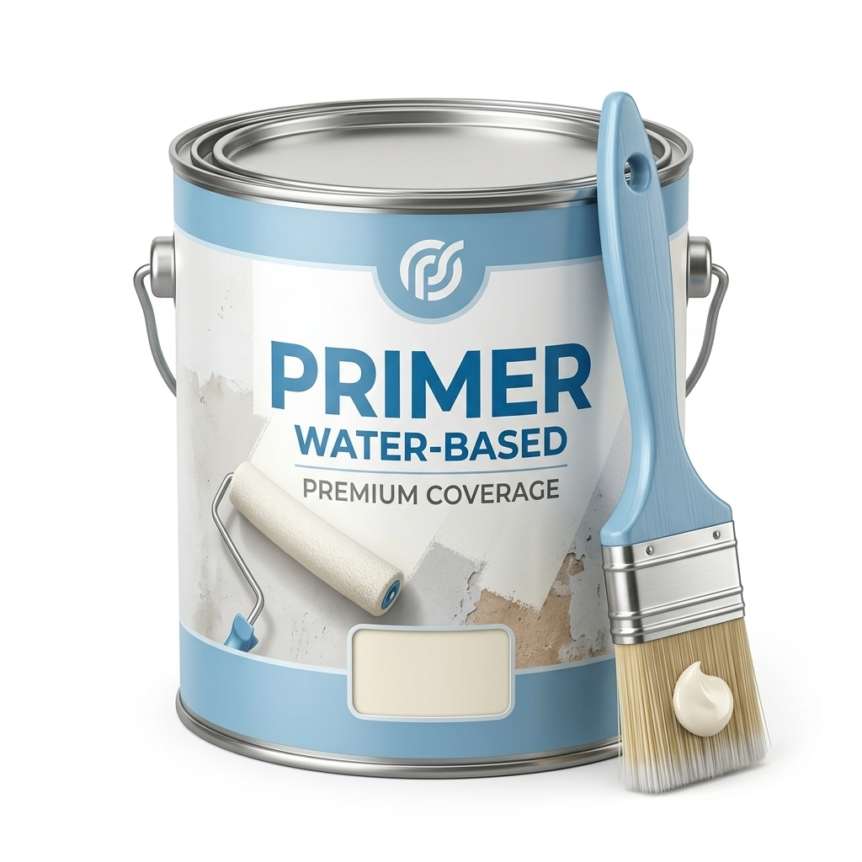
Primer.
Primer is a preparatory coating applied before painting to ensure good adhesion between the surface and the topcoat. It seals porous materials, evens out surface texture, and helps prevent stains or moisture from affecting the finish. Using primer creates a stable base that improves durability and colour consistency in the final paint layer.
Primers are the first coating applied to any new/bare surface and primarily designed to
stick. There are many different primers available for each different type of surface being painted. Acrylic
primer undercoat is regarded as a multipurpose primer/undercoat for wood and plaster/plasterboard.

Slide 46
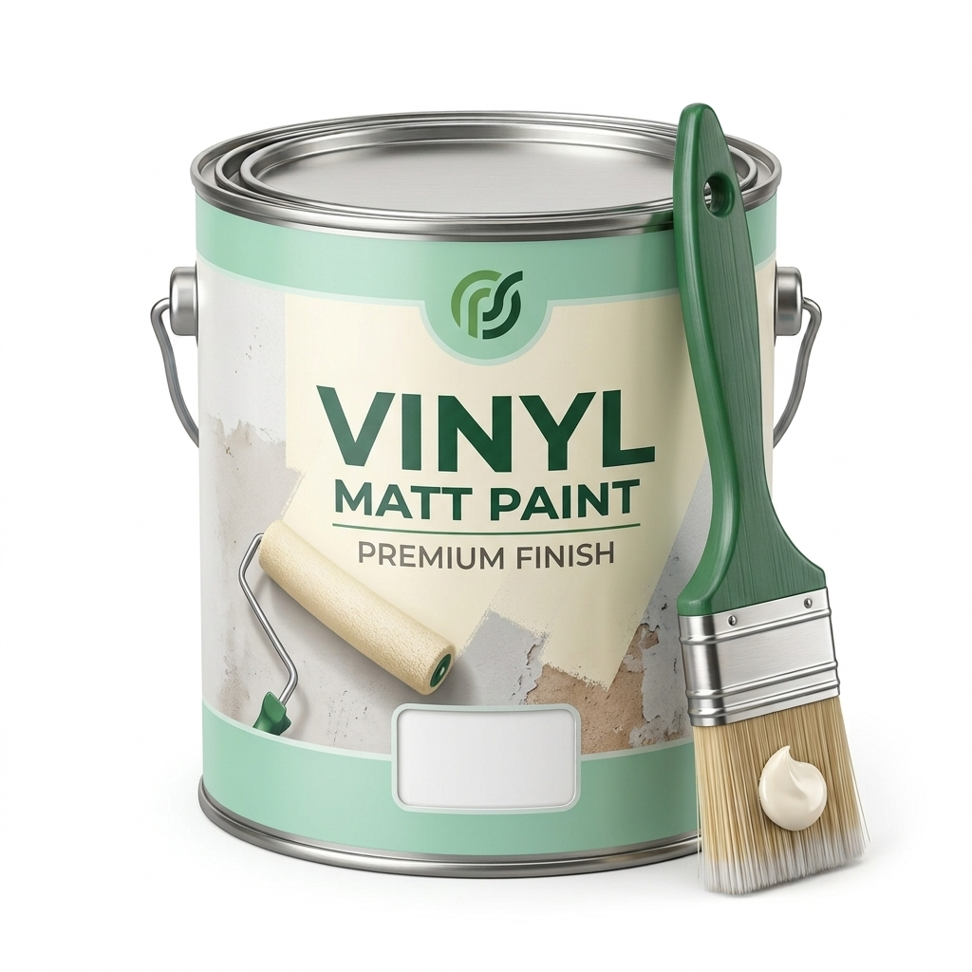
Vinyly Matt.
Vinyl matt paint provides a smooth, non‑reflective finish ideal for ceilings and walls where a soft appearance is desired. It hides minor surface imperfections and offers good coverage, making it a popular choice for living spaces and classrooms. Its low sheen reduces glare and gives a modern, professional look.

Slide 47
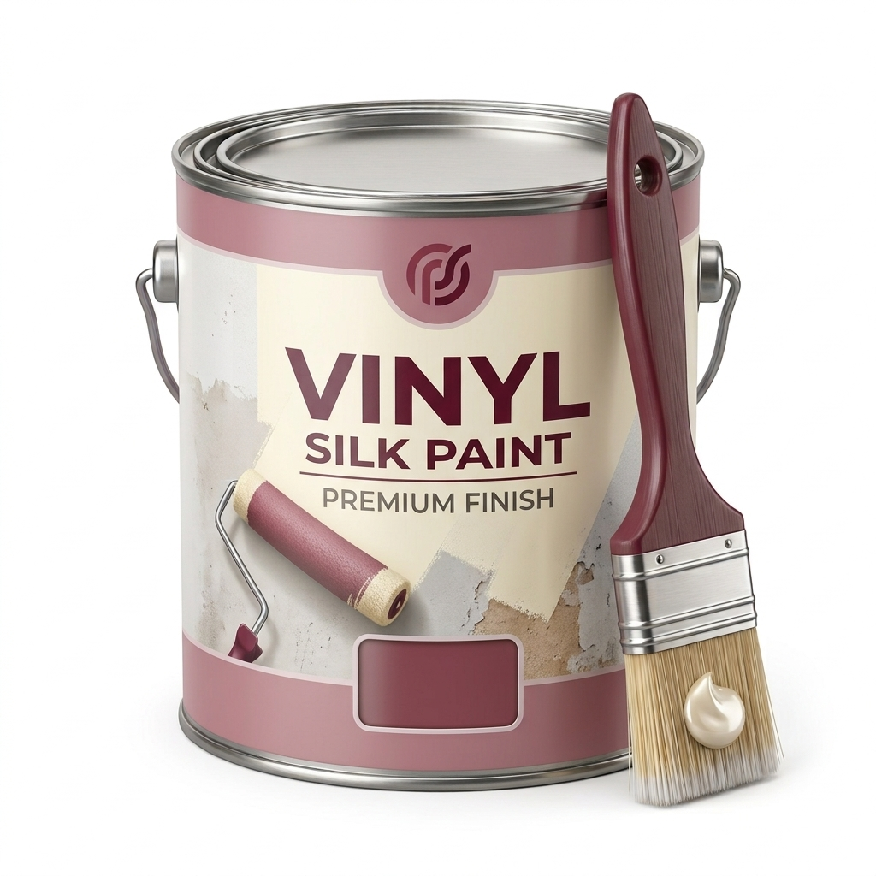
Vinyl Silk.
Vinyl silk paint produces a subtle sheen that reflects light gently, creating a clean and elegant appearance. It’s more washable than matt finishes, making it suitable for areas that need regular cleaning such as corridors or kitchens. The smooth surface enhances colour depth and adds a refined touch to interior spaces.

Slide 48
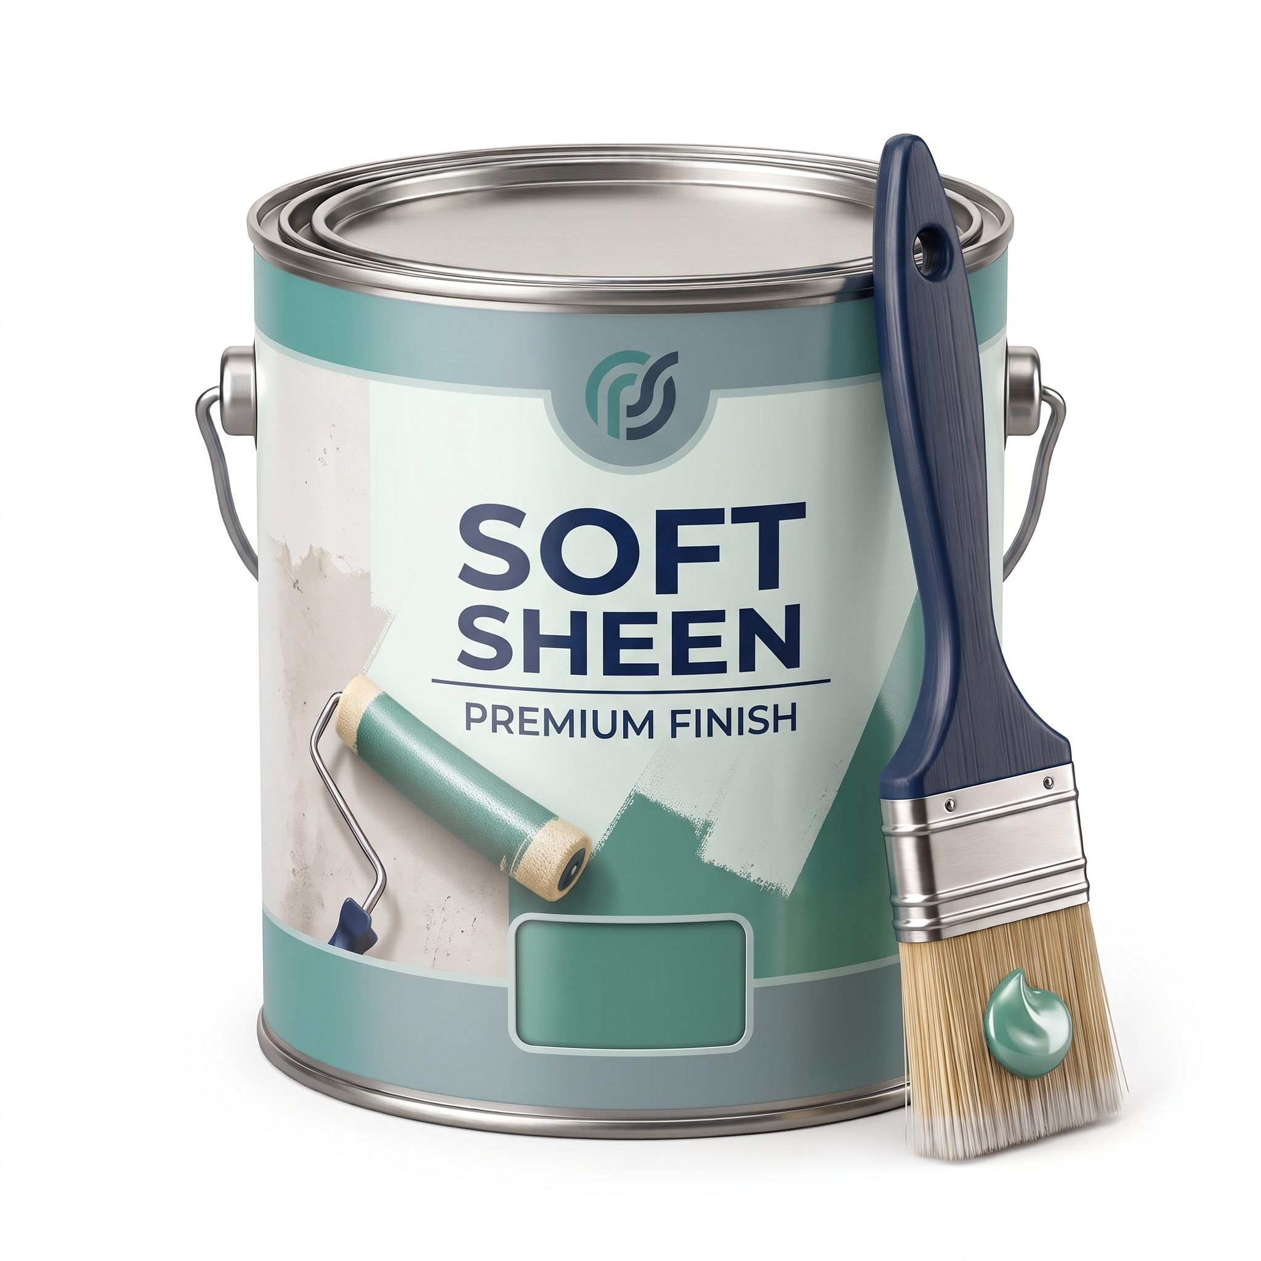
Soft Sheen.
Soft sheen paint sits between matt and silk finishes, providing a gentle glow without excessive shine. It’s durable and easy to wipe clean, making it suitable for family homes, bathrooms, and hallways. The finish balances practicality with aesthetic appeal, offering a subtle light‑reflective quality.

Slide 49
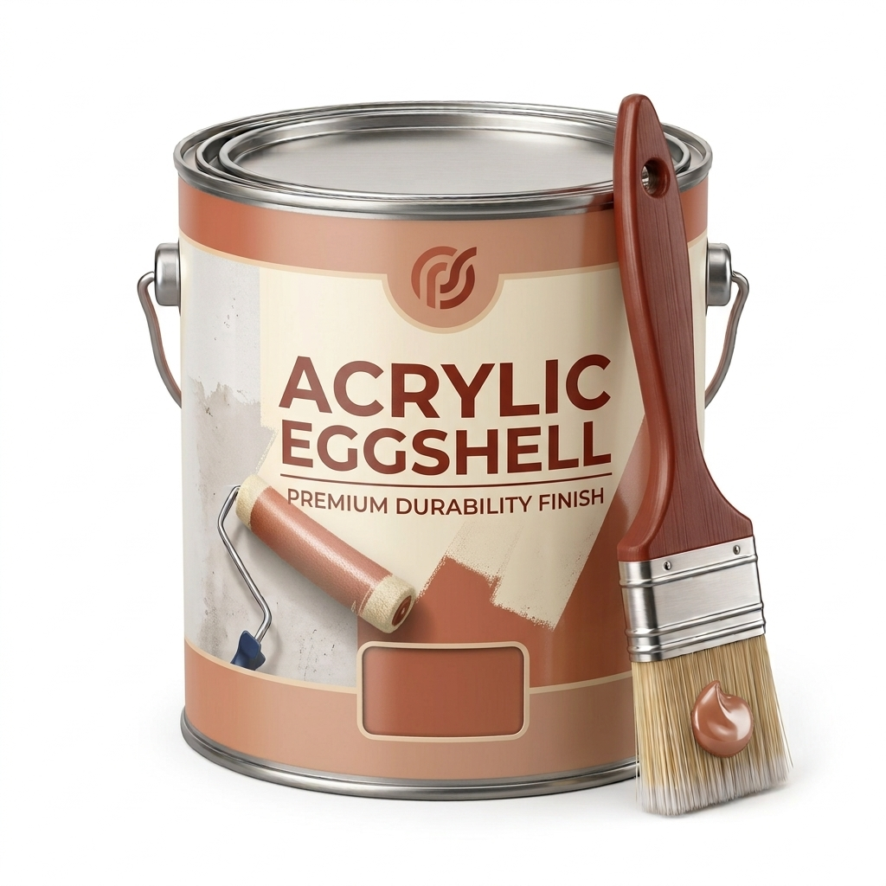
Acrylic Eggshell.
Acrylic eggshell paint delivers a smooth, low‑sheen finish that’s tough and moisture‑resistant. It’s often used in kitchens, bathrooms, and high‑traffic areas where durability and easy maintenance are essential. The finish gives a professional look while protecting surfaces from wear and humidity.

Slide 50
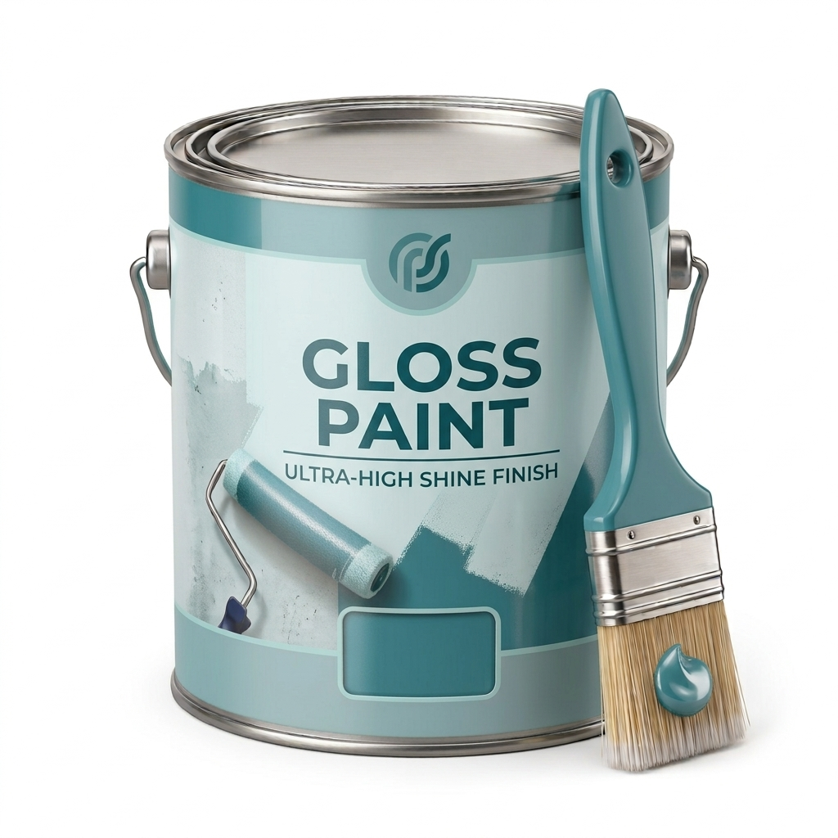
Gloss.
Water‑based gloss paint provides a bright, reflective finish that highlights trim, doors, and woodwork. It dries quickly, emits fewer odours than oil‑based gloss, and resists yellowing over time. Gloss finishes are chosen for their clean, polished appearance and long‑lasting protection.
Also known as either Acrylic, Quick drying or Water-based gloss.

Slide 51

Recap.
Aim:
Know how to prepare and paint surfaces.
Objectives:
1.1 identified the Personal Protective Equipment (PPE) appropriate to preparing and painting surfaces
1.2 identified the materials required to prepare and paint surfaces
1.3 identified the tools and equipment required to prepare and paint surfaces
1.4 stated different types of water-based paints.

Slide 52

Any Questions?.
Do you have any questions?
Please speak to your lecturer if you need support — they will be happy to help. You can also email them at:
Lecturer@college.ac.uk

Slide 53

Thank You.
We would like to take this opportunity to thank you for using this learning resource, we hope you found it useful.
If you have any questions regarding this or any of our learning resources, please contact us on:
educon.rix@gmail.com
Lecturer: James Rix

